Slide 1

Advanced Web Technologies
Prepared by Vivek Thangavelu

Slide 2
Day 1 : Topics
Web architecture & design principles
Client-server model, HTTP, HTTPS
Web servers & request/response cycle
Overview of front-end and back-end frameworks
Environment setup (Node.js, npm, React)
git
HTML5 Refresh
CSS3 Refresh
JS + ES6 Refresh

Slide 3
Day 1 : Practices
Git Commands
Sample application setup
Creating Responsive Web Application using HTML5, CSS3 and JS for (Form Validation)

Slide 4
Web Architecture & Core Internet Concepts
Web Architecture Overview
Design Principles for Scalable Web Apps
Client–Server Model
HTTP Protocol Deep Dive
Web Servers & How They Work

Slide 5
Web Architecture Overview
Definition:
The structure and interaction of all components in a web application — from browser to database.
Web architecture refers to the overall structure of a website or web application, including the way it is designed, implemented, and deployed.

Slide 6
Types of Web Architecture
Monolithic Architecture
Microservices Architecture
Serverless Architecture

Slide 7
Monolithic Architecture
In this traditional approach, all components of the application (front-end, back-end, database, etc.) are bundled into a single, indivisible unit. While simpler to develop initially, it can become challenging to scale and maintain as the application grows.

Slide 8
Microservices Architecture
This architecture breaks down the application into a collection of small, independent services, each running in its own process and communicating via lightweight mechanisms (e.g., APIs). This offers better scalability, flexibility, and fault isolation compare

Slide 9
Serverless Architecture
This model allows developers to build and run applications without managing servers. Cloud providers automatically handle server provisioning, scaling, and maintenance, enabling developers to focus solely on writing code.

Slide 10
Design Principles
Separation of Concerns :
Keep UI, business logic, and data independent
Scalability :
Should handle growth in users & data
Security by Design :
Built-in authentication & encryption
Performance Optimization :
Minimize latency & load time
Maintainability :
Easy to update & debug

Slide 11
Client–Server Model
How It Works:
Client: Web browser/mobile app sending requests
Server: Processes request, sends response
Communication via HTTP/HTTPS
Flow:
User requests a page
Server processes it
Sends back HTML/CSS/JS
Browser renders the page

Slide 12
HTTP Protocol (HyperText Transfer Protocol)
HTTP Methods:
GET – Fetch data
POST – Submit data
PUT – Update data
DELETE – Remove data
Status Codes:
200 OK
404 Not Found
500 Server Error

Slide 13
HTTPS
Secure HTTP using SSL/TLS
Encrypts data in transit
Protects against man-in-the-middle attacks

Slide 14
Web Servers
Purpose: Store, process, and deliver web pages to clients.
Popular Web Servers:
Apache HTTP Server
Nginx
Microsoft IIS
Functions:
Handle HTTP requests
Serve static & dynamic content
Manage connections
Load balancing (in modern setups)

Slide 15
Request & Response Lifecycle
Client sends HTTP request
DNS resolves domain to IP
Web server receives request
Application server executes logic
Database queried if needed
Server sends HTTP response
Browser renders page

Slide 16
Responsive Design, and Web Standards
Responsive vs Adaptive Design
Web Standards & Best Practices
Security & Authentication in Web Apps

Slide 17
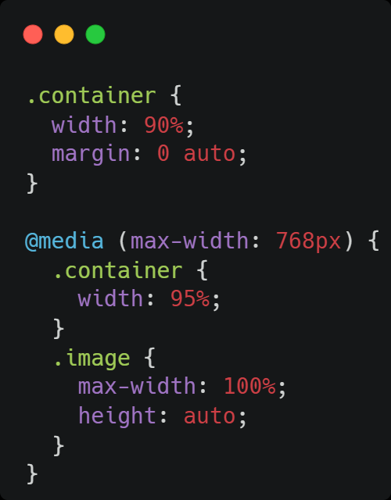
Responsive Web Design
Definition:
A design approach where layouts adapt fluidly to different screen sizes.
Key Techniques:
Flexible grids
CSS media queries
Benefits:
Single codebase for all devices
Improved user experience

Slide 18
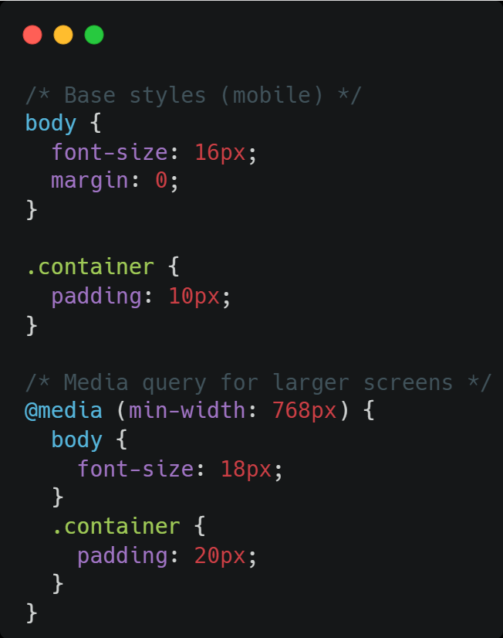
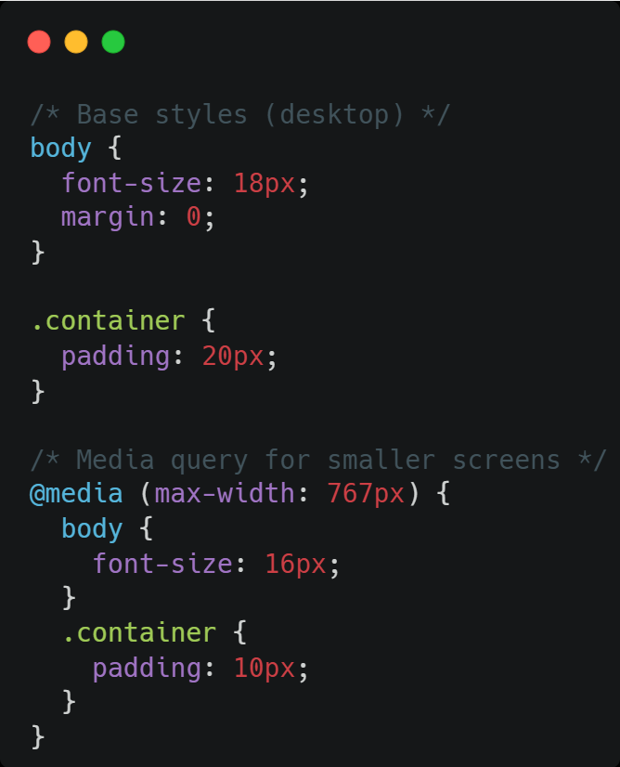
Mobile First vs Desktop First

Slide 19
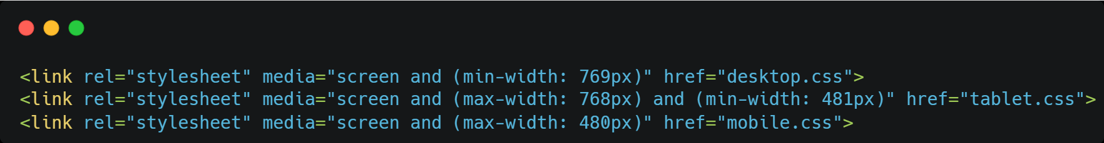
Adaptive Web Design
Definition:
Multiple fixed layouts tailored to specific screen sizes.
Approach:
Predefined breakpoints (e.g., desktop, tablet, mobile)
Loads the layout that matches the device
Difference from Responsive:
Responsive: Fluid, one layout adapts
Adaptive: Several fixed layouts

Slide 20
Web Standards
HTML5, CSS3, ECMAScript specifications
W3C recommendations
Cross-browser compatibility
Semantic HTML for structure
Accessibility compliance

Slide 21
Security in Web Development
Input validation (prevent XSS & SQL Injection)
HTTPS for secure communication
CSRF token protection
Password hashing (bcrypt/argon2)

Slide 22
Authentication Mechanisms
Session-based Authentication
Token-based (JWT) Authentication
OAuth 2.0 for third-party logins
Multi-Factor Authentication (MFA)

Slide 23
Design Patterns
Definition:
Reusable solutions to common problems in software design.
Benefits:
Improved Code Organization and Readability:
Provides a standardized way to structure code, making it easier to understand and navigate.
Enhanced Maintainability and Scalability:
Facilitates future modifications and expansions of the application.
Increased Code Reusability:
Promotes the creation of modular and reusable components.

Slide 24
MVC (Model-View-Controller)
Components:
1. Model – Data & business logic
2. View – UI representation
3. Controller – Handles requests, updates Model & View
Example Flow:
User clicks "Show Profile" → Controller fetches from Model → View displays data
Framework Examples:
Laravel (PHP)
ASP.NET MVC
Ruby on Rails

Slide 25
MVVM (Model-View-ViewModel)
Components:
1. Model – Application data
2. View – UI
3. ViewModel – Mediator between Model & View, handles data binding
Key Advantage:
Two-way data binding keeps UI and data in sync
Framework Examples:
Angular
Vue.js
Knockout.js

Slide 26
Common UI patterns in web design
Navigation: Hamburger menus, breadcrumbs, tabbed navigation, mega menus.
Input & Forms: Date pickers, file upload components, rich text editors, auto-completion, validation feedback, Form Wizard.
Content Display: Card layouts, carousels, accordions, infinite scroll, pagination.
Feedback & Alerts: Toast messages, inline alerts, progress bars, loaders.
Social & Engagement: Social sharing buttons, comment sections, ratings and reviews.

Slide 27
Roadmap
Git
HTML5
CSS3
JS/ES6
React JS

Slide 28
Tools & VS Code Extensions
validator.w3.org
jigsaw.w3.org
caniuse.com
unsplash
pexels
Breakpoints
Web safe fonts
git-scm
Chrome
VS code
Normalize.css
cssgrandient.io
HTML CSS Support
CSS Peak
Prettier
Highlight Matching Tag
Live Server

Slide 29
Git: Frequently Used Commands
git config
git init
git add
git add *
git add .
git status
git status -s
git commit -m “”
git commit -am “”
git ls-files
git log –oneline -5 –reverse
git show CommitID

Slide 30
HTML
Hypertext Markup Language (HTML) is the standard markup language for documents designed to be displayed in a web browser.
HTML isn’t case-sensitive, Always use lower case for naming convention
Opening, Closing, and Self-Closing Tages
URL (Uniform Resource Locator)
Resources
Web Pages (HTML Documents)
Images
Videos
Audios
Fonts

Slide 31
HTML : Meta
<meta />
Character Set (ASCII [American Standard Code for Information Interchange], UTF-8 [Unicode Transformation Format])
The meta charset="utf-8" tag in HTML is used to specify that the webpage should be interpreted using UTF-8 encoding. This ensures that all characters on the page, including special characters and emojis, are displayed correctly.
Viewport
Title
Keywords
Description
OG : Open Graph

Slide 32
HTML : Elements
Text
Links
Images
Lists
Tables
Containers Elements
Structural Elements

Slide 33
HTML : Text
h1 to h6
<p>
<em>
HTML Entities : &lt; &gt; &copy;
<b>
<i> <u>
<mark>
<del>
<sup>
<sub>
<hr>
<br>

Slide 34
HTML : Links
anchor tag
<a>
href - Hyper Reference
Internal Page Link
External Link
mailto
tel
target
download

Slide 35
HTML : Images, & Iframe
<img>
src
Alt
<iframe>

Slide 36
HTML : Table
<table>
<thead>, <tbody><tfoot>
<tr>, <th>, <td>
<caption>
Colgroup
Col (Style, Span)
Rowspan, Colspan

Slide 37
HTML : Containers Elements
<div> Block Level Element
<span> Inline Element : Decoration, Styling

Slide 38
HTML : Structural Elements
<ol> Ordered List
reversed
start
type
<dl> Description List
<dt> Description Term
<dd> Description Definition
<ul> Unordered List

Slide 39
Advanced HTML5 Features
HTML5 brought many new elements and attributes to improve the structure, semantics, and functionality of web pages.
Semantic tags:
These tags provide meaning and structure to your content, making it easier for browsers and developers to understand the purpose of each section. Examples include <header>, <nav>, <section>, <article>, <aside>, <footer>, <main>, <mark>, and <time>.
Multimedia tags:
HTML5 made it easier to embed multimedia content directly into your webpages. These include <audio>, <video>, <source>, <track>, <figure>, <figcaption>, and <canvas>.

Slide 40
Advanced HTML5 Features
Form tags and input types:
HTML5 significantly enhanced forms, making them more powerful and easier to use. Key tags include <form>, <input>, <textarea>, <button>, <select>, <option>, <optgroup>, <label>, <fieldset>, <legend>, <datalist>, and <output>

Slide 41
Video and audio elements
HTML5 introduced the <video> and <audio> tags, enabling direct embedding of video and audio content
<video> tag:
Displays video content with attributes like src (video file source), controls (for play/pause, volume etc.), width, height, autoplay, loop, muted, and poster (for a placeholder image before video loads)
<audio> tag:
Similar to video, this tag embeds audio files and includes attributes like src, controls, autoplay, loop, and muted

Slide 42
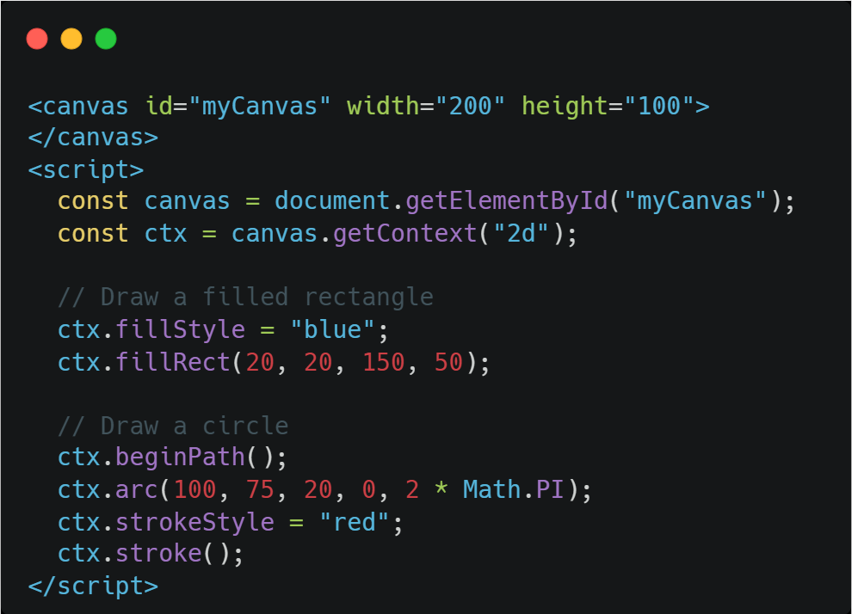
Canvas Elements
The HTML5 Canvas API empowers web developers to draw graphics and animations directly within a web page, using JavaScript. It's a pixel-based approach, essentially providing a drawable region on the HTML page where visuals are created and manipulated using sc

Slide 43
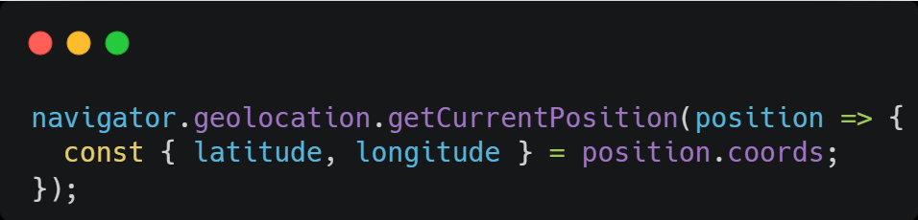
Geo Location API
The HTML5 Geolocation API allows web browsers to access a user's geographical location (latitude and longitude coordinates) with their explicit permission.

Slide 44
CSS : Cascading Style Sheet (Styling Lang.)
Inline CSS
Internal Styles
External Styles

Slide 45
CSS : Selectors
Basic Selectors
Relational Selector
Pseudo Class Selector
Pseudo Element Selector

Slide 46
CSS : Basic Selectors
Element Type
Attribute
a[href=””] Exact
a[href*=””] Contains
a[href^=””] Starts
a[href$=””] Ends
a[href^=””], a[href$=””] Combined
ID
#elemID
Class
.elemCls

Slide 47
CSS : Relational Selectors
Descendent Selector : #elem p
Direct Child Selector : #elem > p
Siblings Selector : #elem + p
General Siblings Selector : #elem ~ p

Slide 48
CSS : Pseudo Class Selectors
div:first-child
div:first-of-type
div:last-child
div:last-of-type
li:nth-child(odd)
li:nth-child(even)
li:nth-child(3n)
a:visited
a:hover
a:focus

Slide 49
CSS : Pseudo Element Selectors
p:first-letter
p:first-line
p::selection
::root
p::before
p::after

Slide 50
CSS : Selectors Specificity
ID Selectors
Class & Attribute Selector
Element Selector

Slide 51
CSS : Inheritance & Colors
Inherit
Colors
Named Colors
RGB
RGBA (A - Alpha [0 - Completely Transparent, 1 - Completely Opac, 0.5 - Semi-Transparent])
HSL (Hue, Saturation, Lightness [Degree, 0-100%, 0-100%])
HSLA
HexaDecimal

Slide 52
CSS : Gradients, Borders and Shadows
Technically Gradients are Images
Types
Linear
Radical
Shadows
Borders

Slide 53
CSS - Units
Units in CSS define the size or dimension of elements. They fall into two main categories:
Absolute Units:
Have a fixed size regardless of the context. Common examples include px (pixels), pt (points), cm (centimeters), mm (millimeters), in (inches), and pc (picas).
Relative Units:
Adapt based on other values, offering more flexibility for responsive design. Examples include % (percent, relative to the parent), em (relative to font size), rem (relative to root font size), vw and vh (relative to viewport width and height), vmin, vmax, and ch

Slide 54
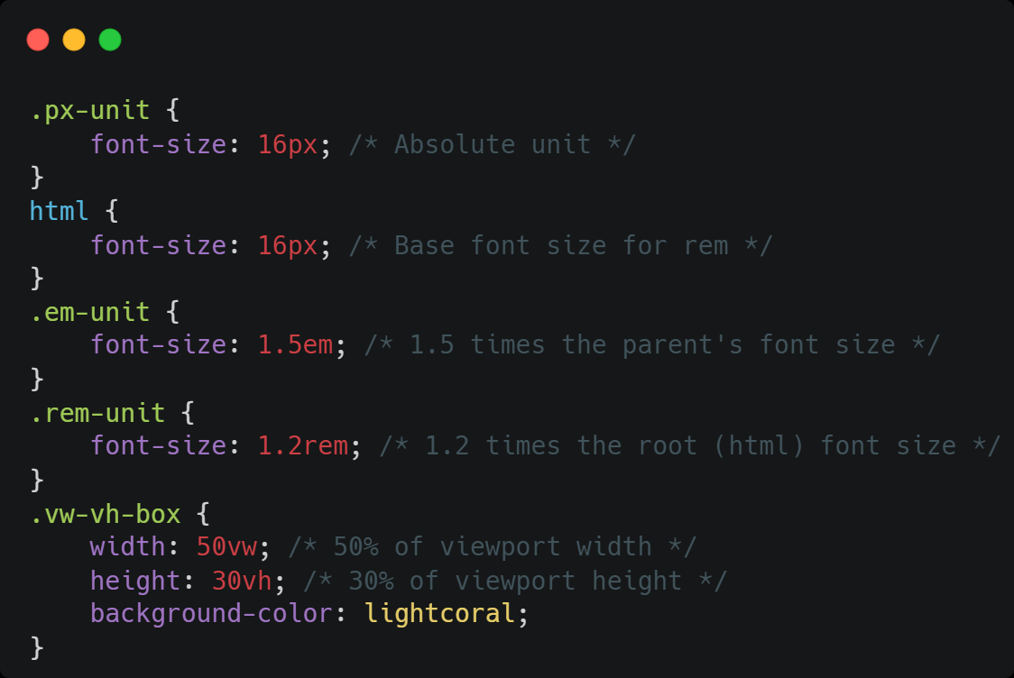
CSS - Units ~ Code

Slide 55
CSS - Box Model
The CSS Box Model treats every HTML element as a rectangular box with four layers:
Content (the element's actual content)
Padding (space between content and border)
Border (the visible boundary)
Margin (space outside the border)
The box-sizing property, particularly border-box, simplifies responsive designs by including padding and borders within the element's total dimensions.

Slide 56
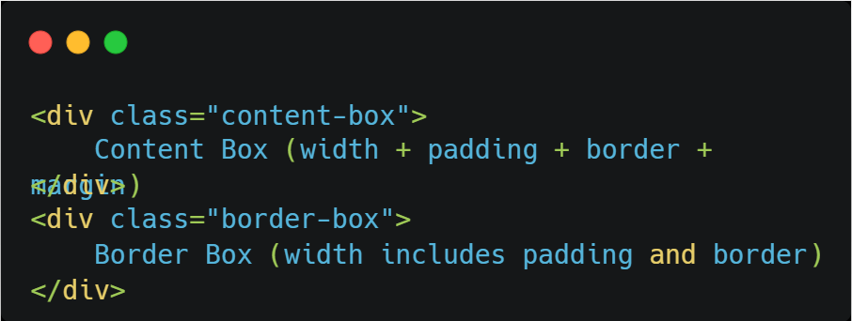
CSS - Box Model ~ HTML Code

Slide 57
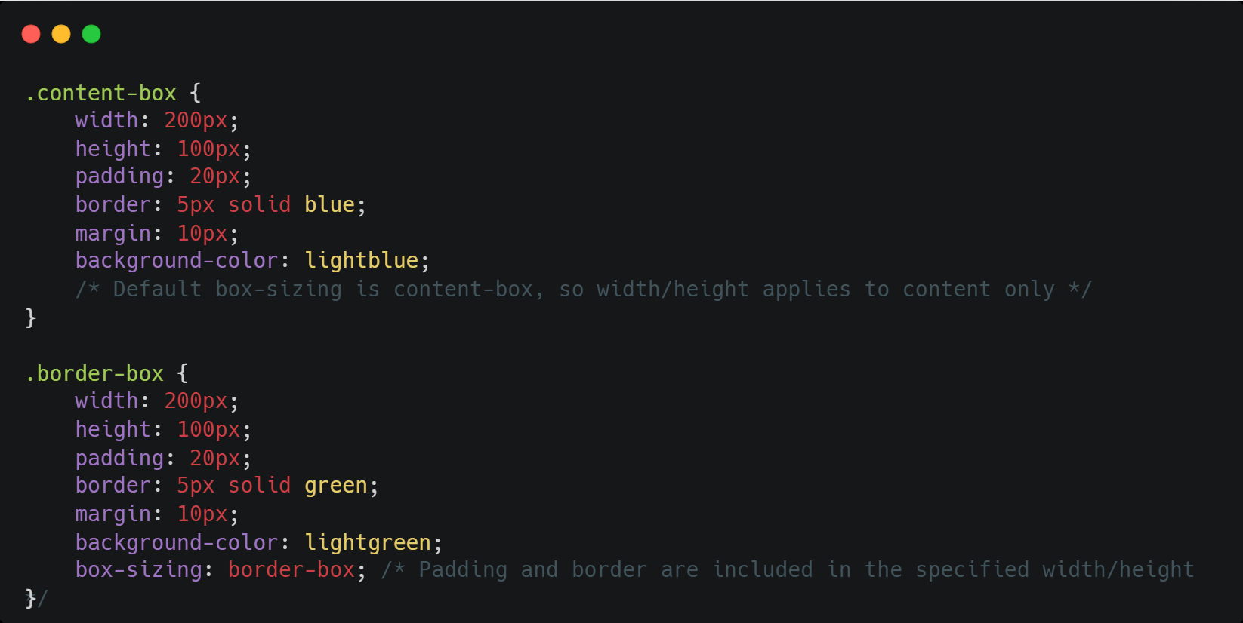
CSS - Box Model ~ CSS Code

Slide 58
CSS - Positioning
The position property controls an element's placement in the document flow:
static (default): Normal document flow positioning.
relative: Positioned relative to its original spot, but still occupies its original space. Use top, right, bottom, left to adjust.
absolute: Removed from normal flow, positioned relative to the nearest positioned ancestor or the initial containing block.
fixed: Positioned relative to the viewport, stays put during scrolling, and is removed from normal flow.
sticky: Acts like relative until a scroll threshold is met, then becomes fixed. Requires top, right, bottom, or left

Slide 59
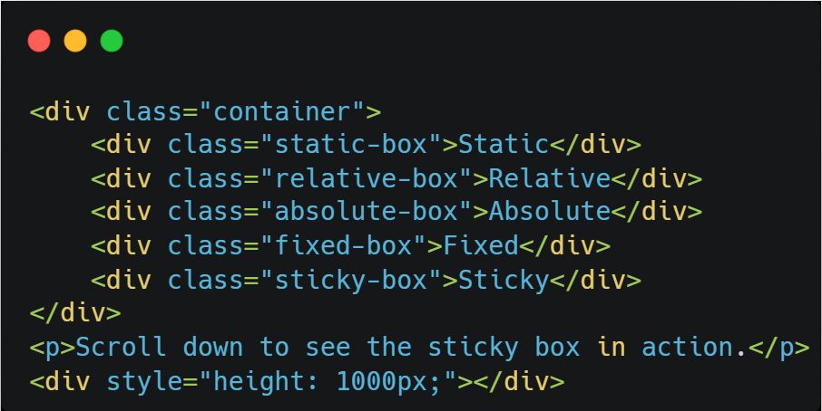
CSS - Positioning ~ HTML Code

Slide 60
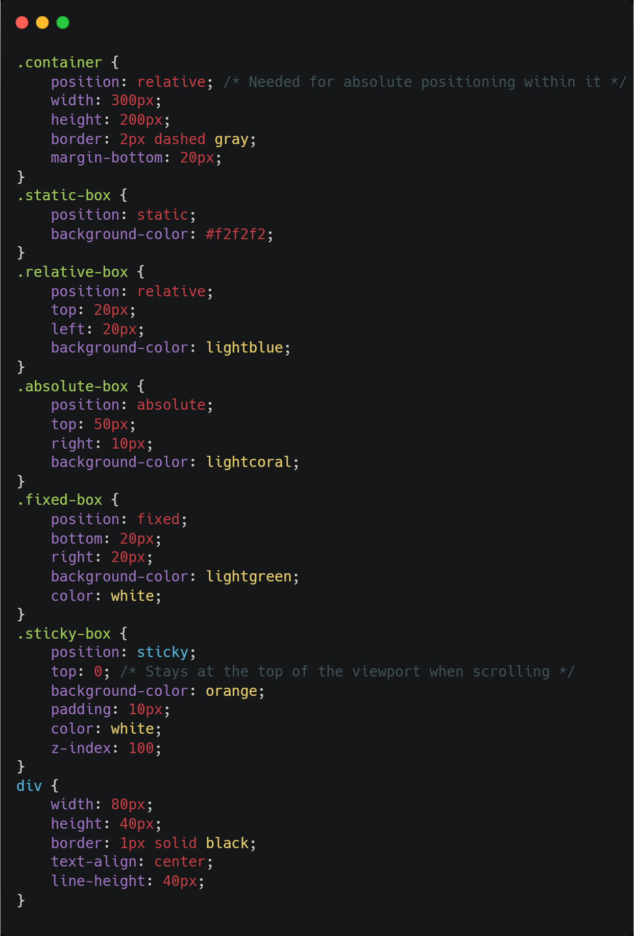
CSS - Positioning ~ CSS Code

Slide 61
CSS - Flexbox (flexible box layout)
Flexbox is a one-dimensional layout model for arranging items in a container, either as a row or a column. MDN Web Docs says Flexbox deals with layout in one dimension at a time—either as a row or as a column Key concepts include the Main Axis (flex-direction

Slide 62
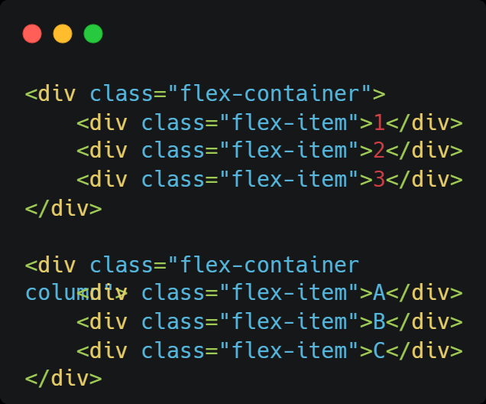
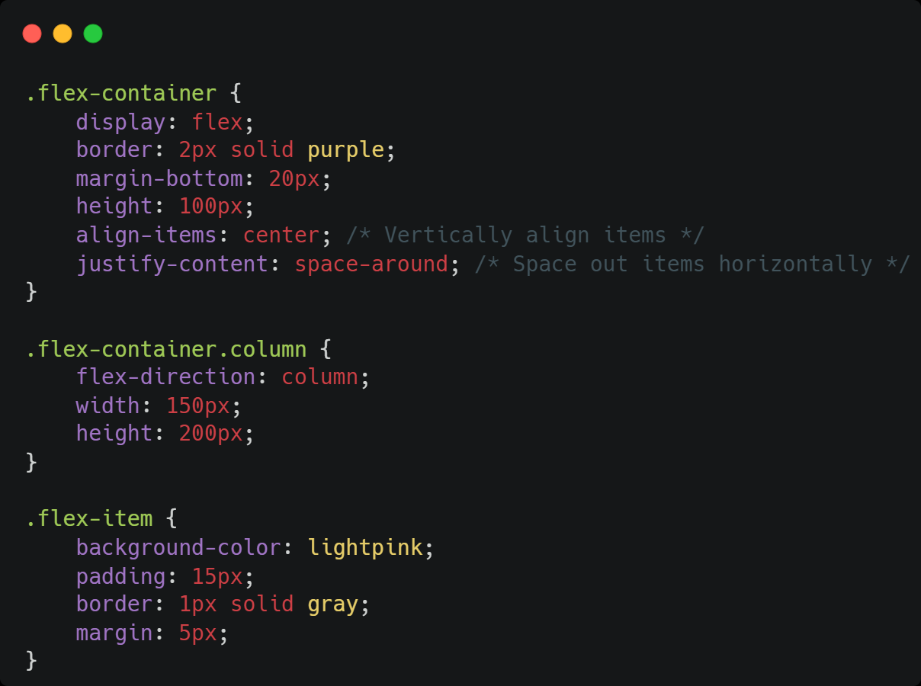
CSS - Flexbox ~ Code

Slide 63
CSS - Grid
CSS Grid is a two-dimensional layout system for creating complex and responsive designs with control over rows and columns. It involves a Grid Container (display: grid), Grid Items, Grid Lines, Grid Columns (grid-template-columns), and Grid Rows (grid-template-rows). You can add space with Grid Gaps (gap). Grid Areas allow named sections for easier item placement using grid-template-areas and grid-area.

Slide 64
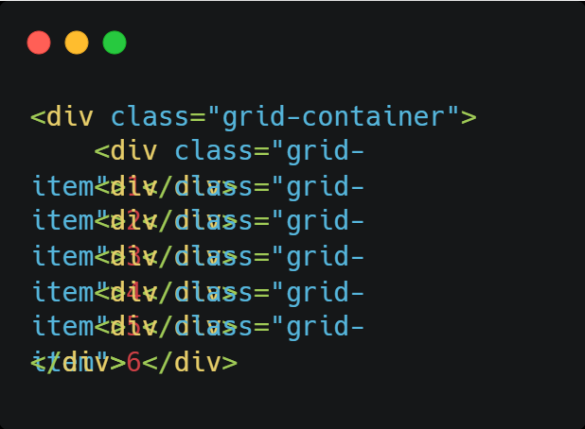
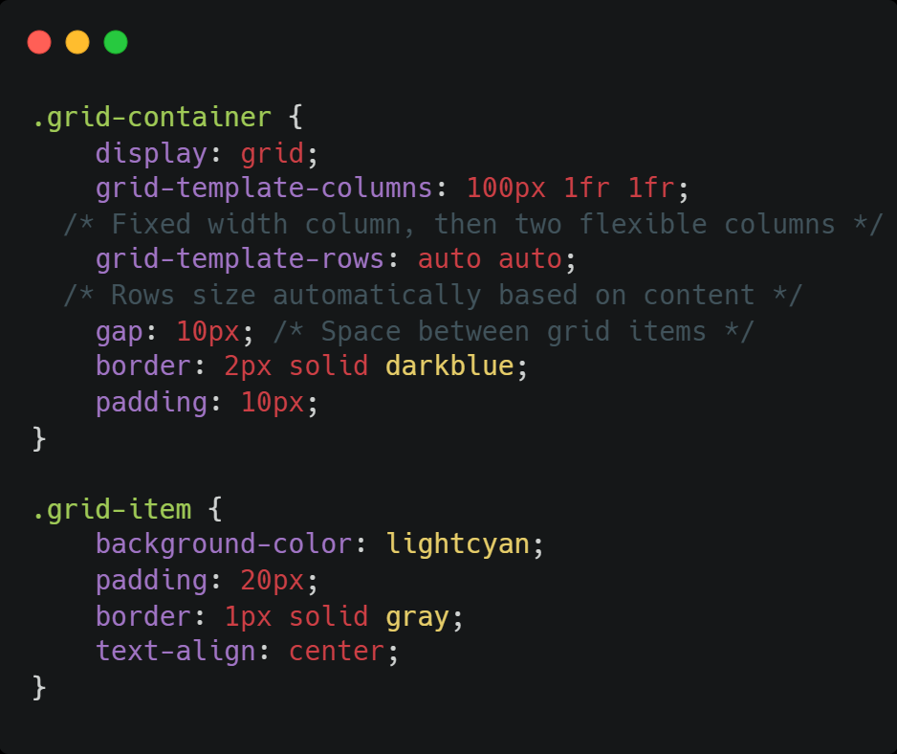
CSS - Grid ~ Code

Slide 65
CSS - Media queries
Media queries enable responsive design by applying styles based on device characteristics like screen size or orientation. They use the @media rule and breakpoints where styles change for different screen sizes. BrowserStack says breakpoints ensure your website adapts to different screen sizes, resulting in a responsive design that ensures optimal user experience across all devices Conditions like min-width and max-width determine when styles apply. They're used for flexible layouts, showing/hiding elements, and adjusting font sizes.

Slide 66
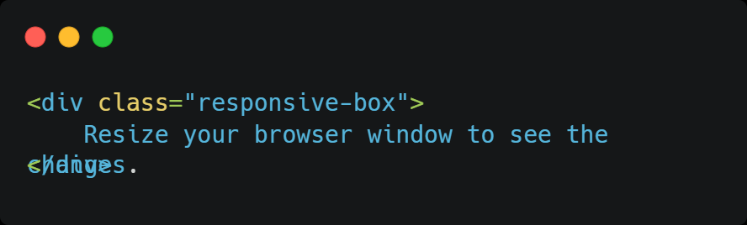
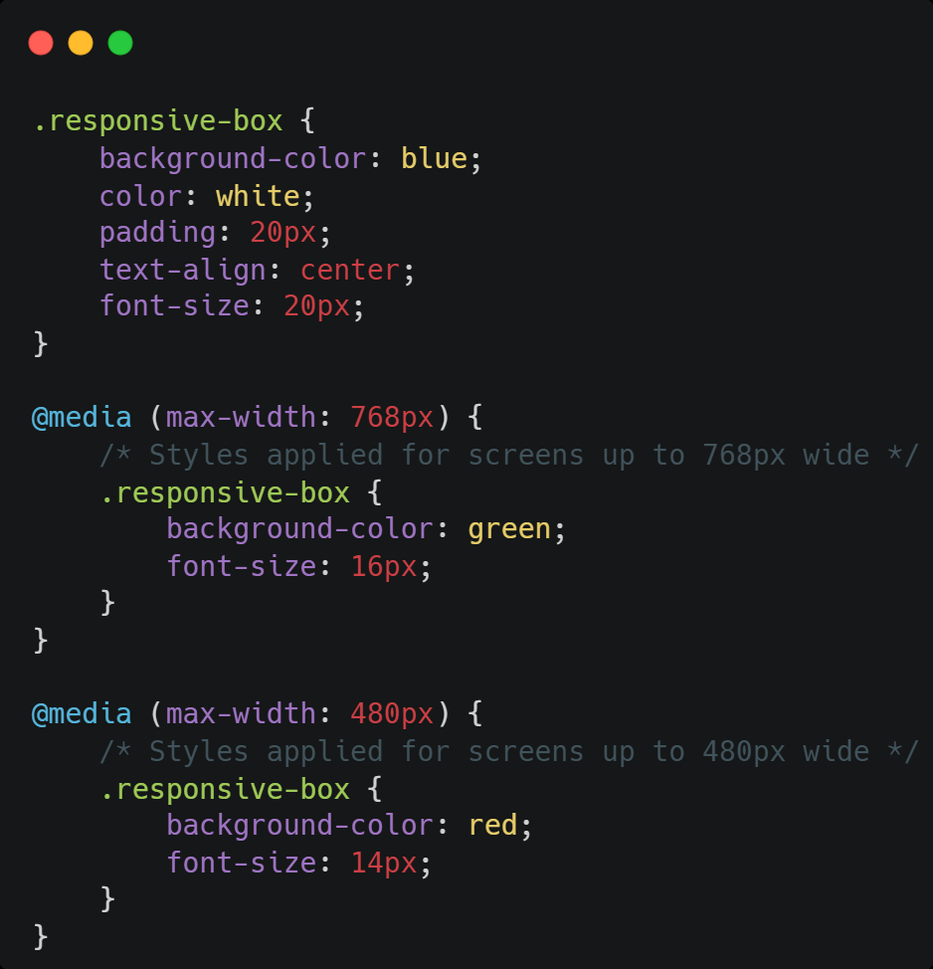
CSS - Media Queries ~ Code

Slide 67
CSS - Variables
CSS Variables, or custom properties, allow defining reusable values in stylesheets for better maintainability and consistency. SitePoint says CSS Variables allow you to set values once and use them many times throughout your codebase They use the -- prefix (e.g., --main-color: blue;) and are accessed with var() (e.g., color: var(--main-color);).

Slide 68
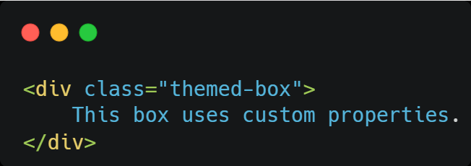
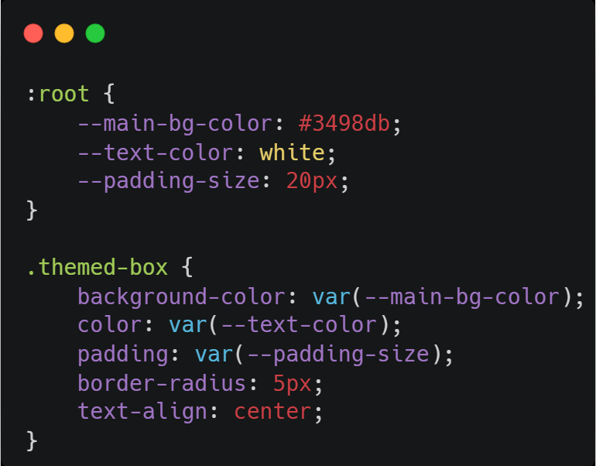
CSS - Variables ~ Code

Slide 69
CSS - Transforms
Transforms modify an element's position, rotation, scale, and skew for dynamic effects. They are performant for animations as they don't trigger layout changes. GUVI mentions how animating transform and opacity properties are optimized for transitions and can be animated smoothly without causing a hiccup in your website's performance The transform property is used with functions like translate(), rotate(), scale(), and skew().

Slide 70
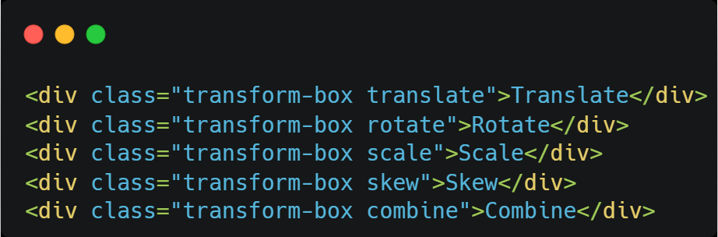
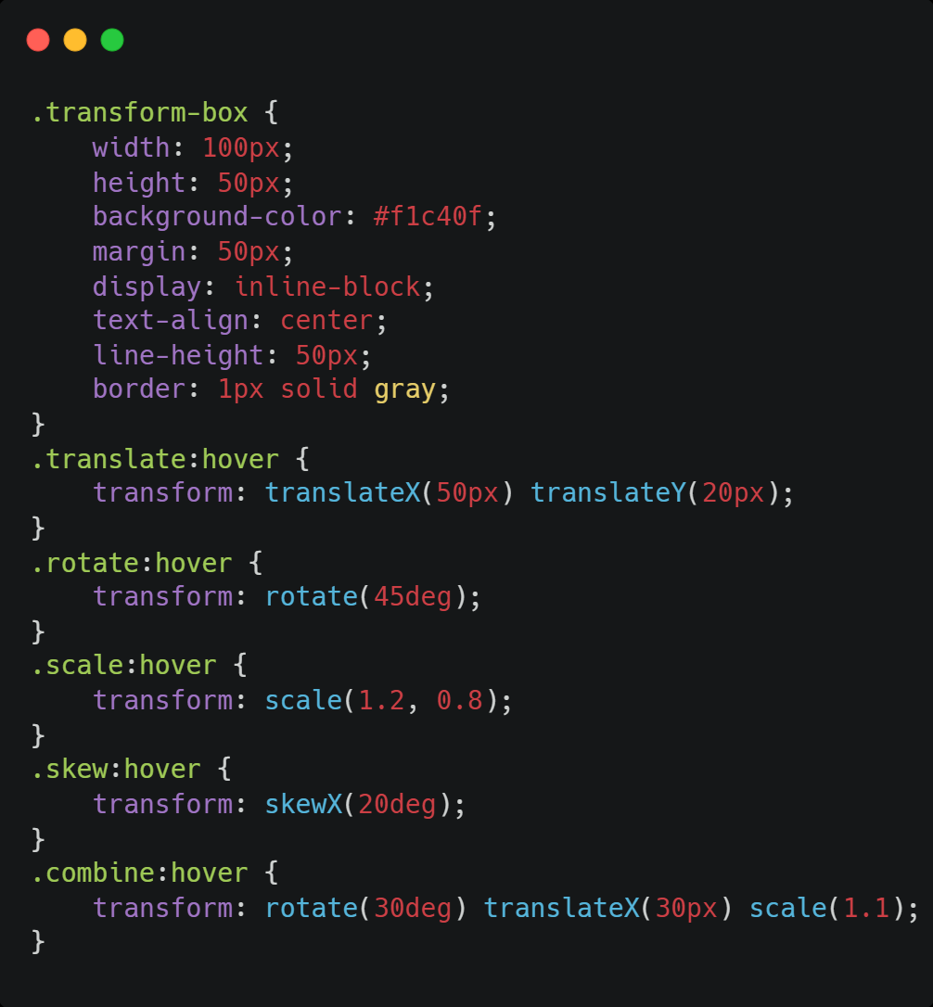
CSS - Transforms ~ Code

Slide 71
CSS - Transitions
Transitions create smooth animations for property changes over time, often triggered by state changes like hover or focus. Key properties include transition-property (what to animate), transition-duration (how long), transition-timing-function (speed curve),

Slide 72
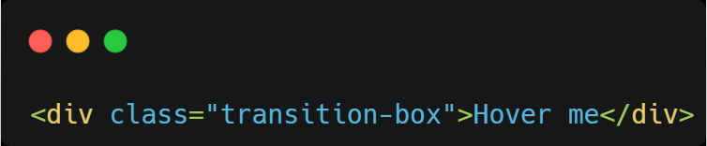
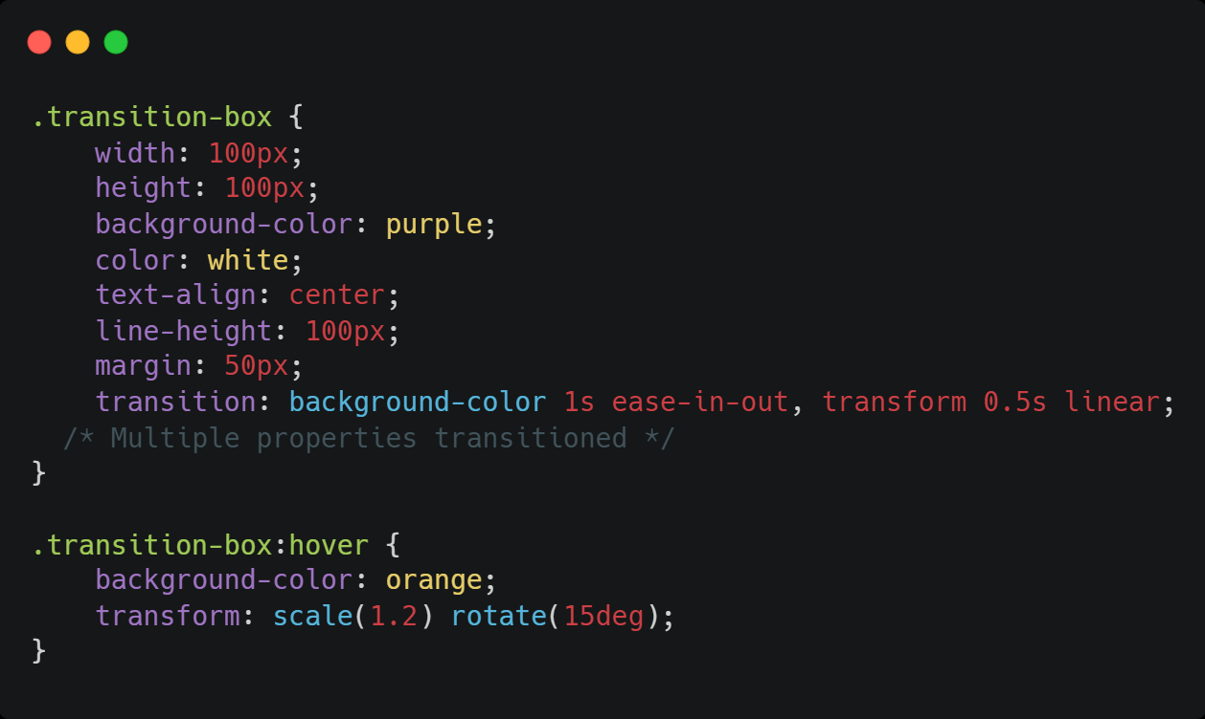
CSS - Transitions ~ Code

Slide 73
CSS - Animations
Animations offer more advanced motion control using @keyframes to define stages of an animation. Properties like animation-name (links to keyframes), animation-duration, animation-timing-function, animation-delay, animation-iteration-count, animation-direction, and animation-fill-mode control the animation. animation-play-state controls running or pausing. The animation shorthand combines these. Animations are used for loops, complex movements, and dynamic effects.

Slide 74
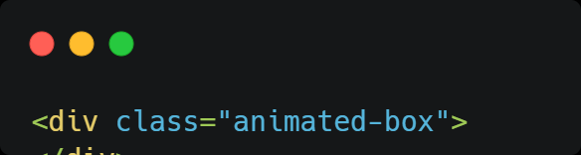
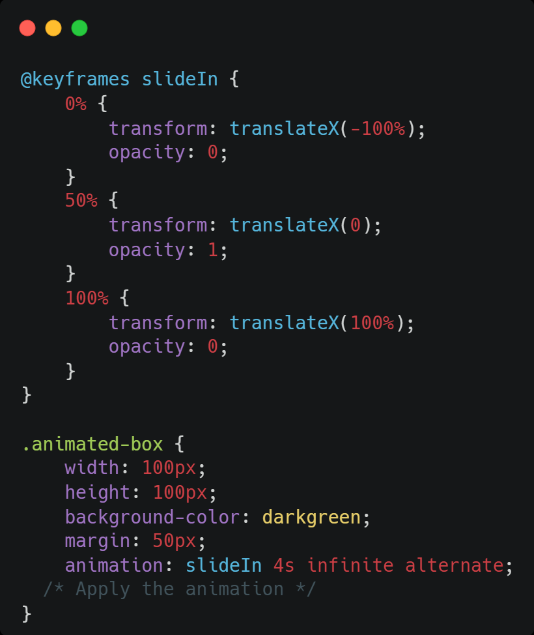
CSS - Animations ~ Code

Slide 75
JavaScript
JavaScript, a dynamically-typed language, has a wide range of features, from basic data types and operators to advanced concepts like Promises and Modules. Mastering these concepts is essential for building robust and interactive web applications.

Slide 76
Data types
Data types classify values that can be stored and manipulated in JavaScript. They are broadly categorized into two types:
Primitive Data Types
Non-Primitive Data Types

Slide 77
Primitive Data Types
Number: Represents numerical values, including integers and floating-point numbers. Example: let age = 30;
String: Represents textual data, enclosed in single or double quotes. Example: let name = "Alice";
Boolean: Represents logical values: true or false. Example: let isAdmin = true;
Undefined: Represents a variable that has been declared but not yet assigned a value. Example: let score;
Null: Represents the intentional absence of any object value, meaning "no value" or "empty". Example: let user = null;

Slide 78
Non-Primitive Data Types
Object: A collection of key-value pairs, representing complex data structures like arrays and functions. Example: let person = { name: "Bob", age: 25 };

Slide 79
Operators
Arithmetic Operators : Perform mathematical calculations (+, -, *, /, %, ** for exponentiation).
Comparison Operators : Compare values and return a boolean (true or false)
Logical Operators: Combine or modify boolean expressions (&& (AND), || (OR), ! (NOT)).
Assignment Operators: Assign values to variables (=, +=, -=, *=, etc.)
String Operators: Concatenate strings (+)
Ternary Operator: A shorthand for if-else statements.

Slide 80
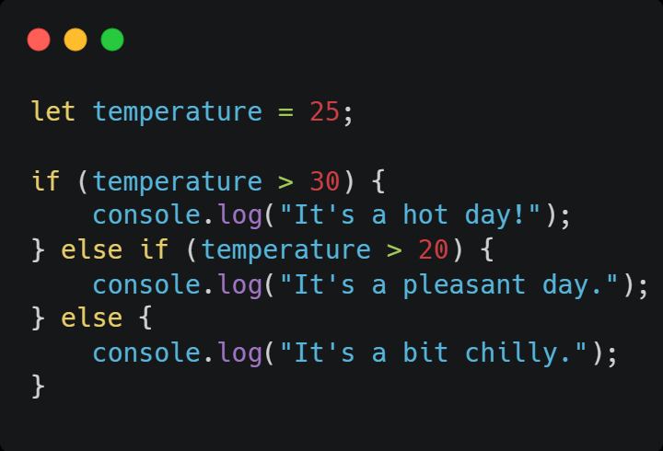
if-else
if-else statements execute code blocks based on conditions.

Slide 81
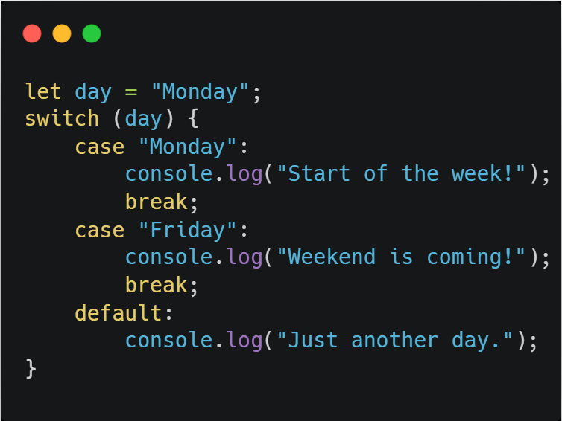
Switch statements
switch statements evaluate an expression and execute code based on matching cases.

Slide 82
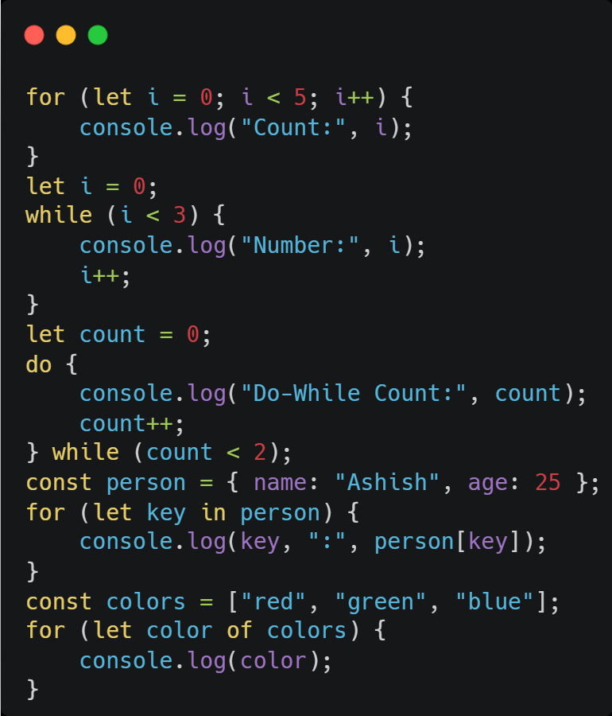
Loops
Loops repeatedly execute code blocks until a condition is met.
for loop: For a known number of iterations. while loop: Executes as long as a condition is true.
do-while loop: Executes the block at least once, then checks the condition.
for-in loop: Iterates over object properties.
for-of loop: Iterates over iterable objects like arrays, strings, etc

Slide 83
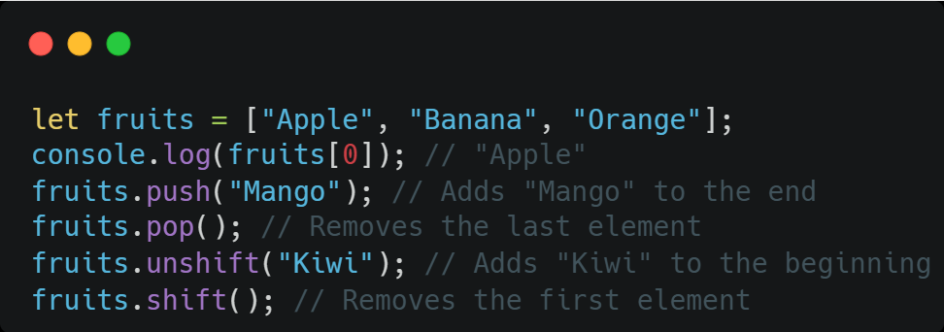
Arrays
Arrays store ordered collections of data, accessible by numerical indices.

Slide 84
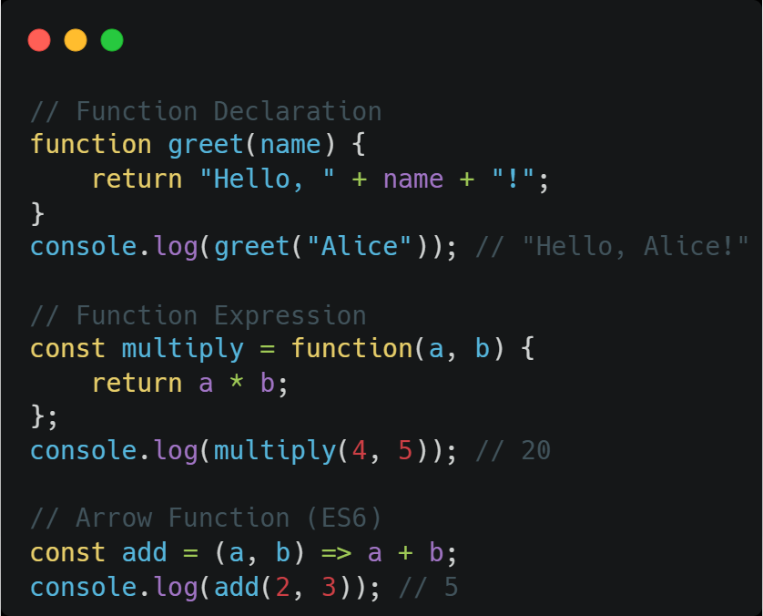
Functions
Functions are blocks of reusable code, performing specific tasks.

Slide 85
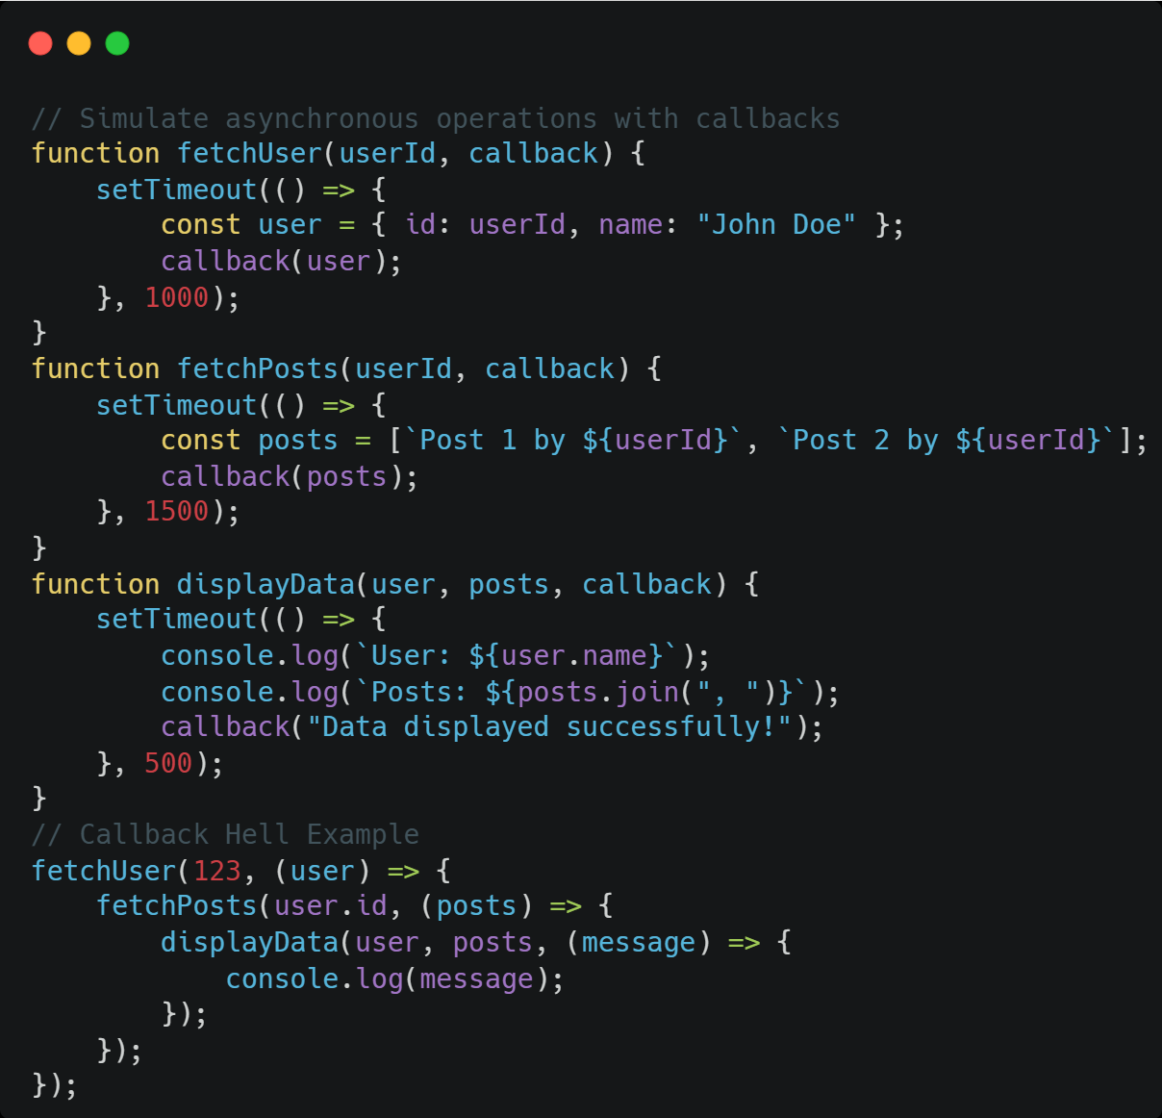
Callback Hell
Callback hell, also known as "pyramid of doom," occurs when multiple nested callbacks make asynchronous code difficult to read, maintain, and debug

Slide 86
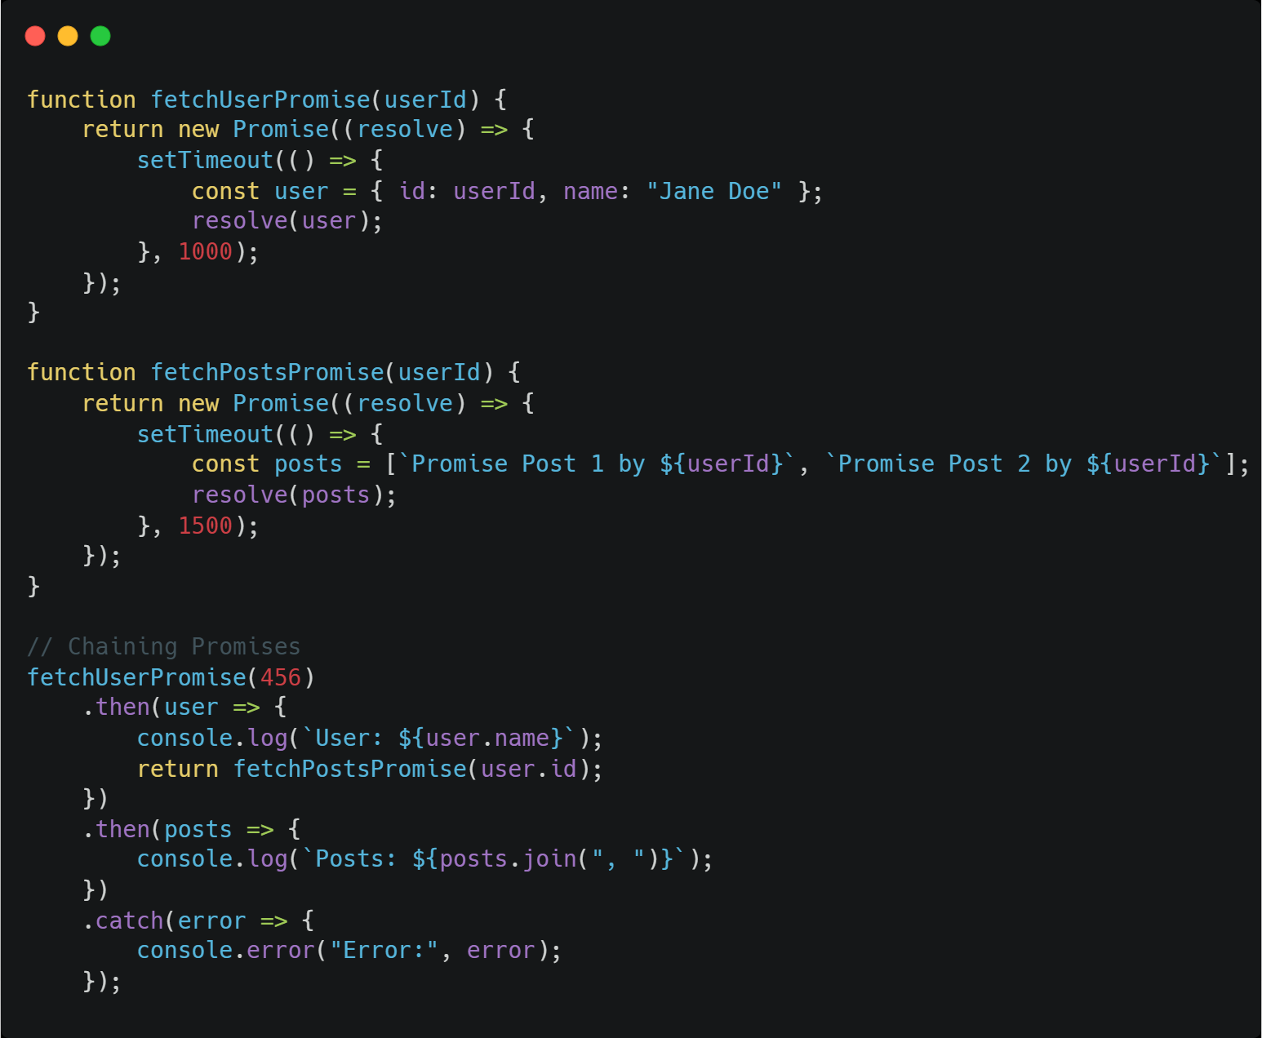
Promises
Promises provide a structured way to handle asynchronous operations, reducing the complexity of callback hell.

Slide 87
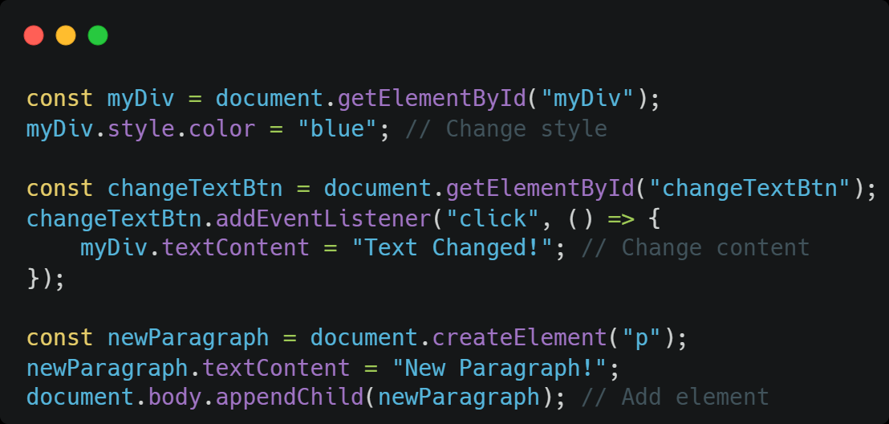
DOM manipulation
DOM (Document Object Model) manipulation involves dynamically modifying the structure, content, and style of HTML elements. GeeksforGeeks describes DOM manipulation as dynamically modifying the structure, content, and style of HTML elements

Slide 88
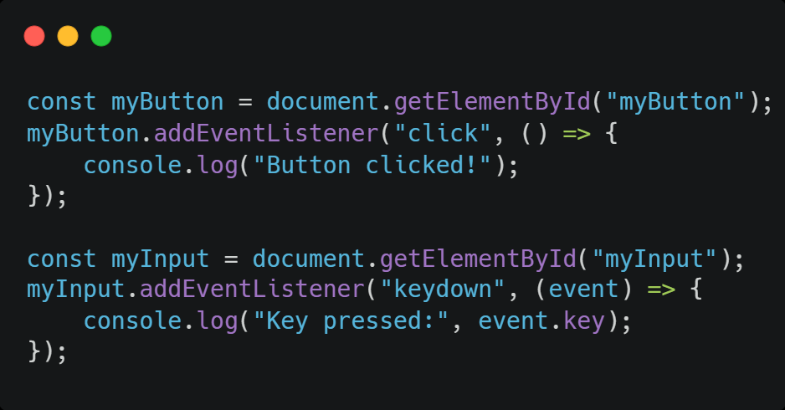
Events
Events are actions that occur in the browser, such as clicks, keyboard presses, or page loading.

Slide 89
Modules
JavaScript modules provide a powerful way to organize and structure your code into smaller, reusable, and self-contained units. Think of them as individual files that contain specific pieces of code, such as functions, variables, classes, or objects, related

Slide 90
Modules : Concepts
Exporting: The export keyword is used to make specific parts of a module (functions, variables, etc.) accessible to other modules.
Importing: The import keyword is used to bring exported features from other modules into the current file.
Named Exports: Allow exporting multiple items from a module, each with a specific name, and imported using curly braces {} with the exact name.
Default Exports: Allow exporting a single primary value (function, class, object) from a module, and imported without curly braces using any name.
Strict Mode: Module code automatically runs in strict mode, even without the "use strict"; declaration, according to MDN Web Docs.

Slide 91
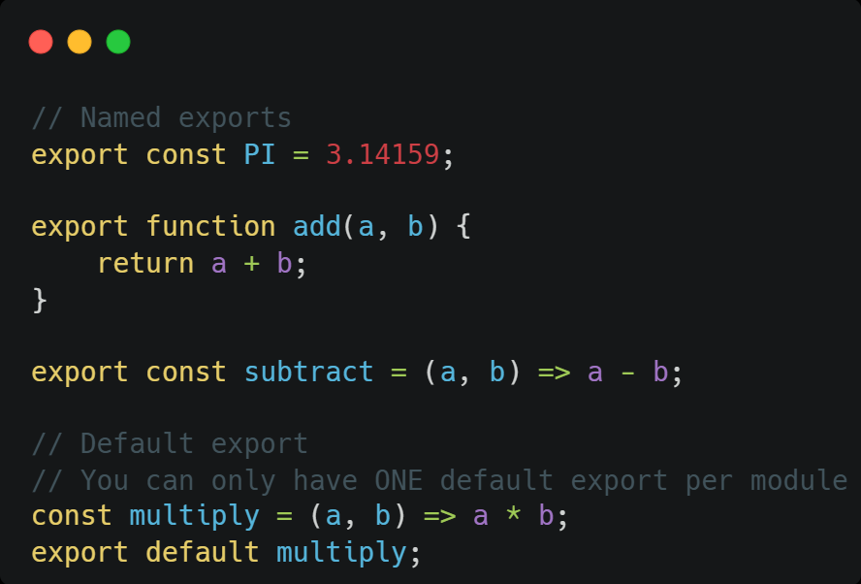
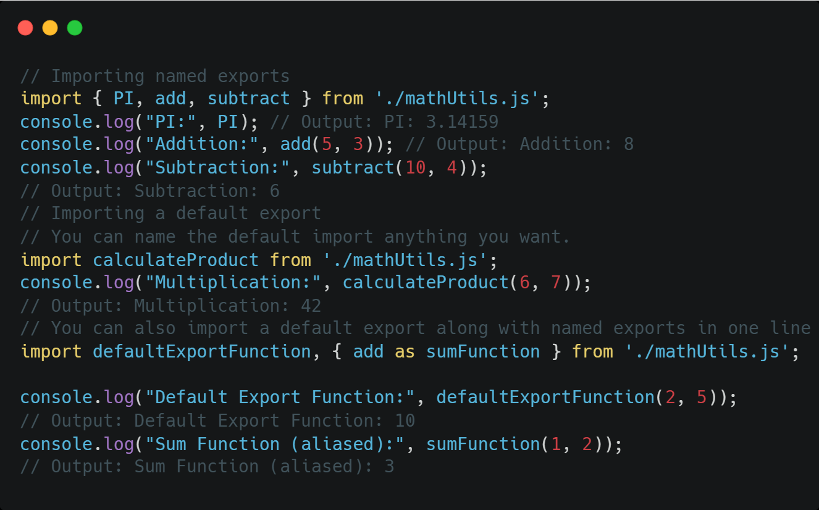
Modules : Concepts

Slide 92
ES6
let & const (Block Scope)
Arrow Functions
Template Literals
Destructuring (Objects & Arrays)
Parameters & Arguments
Default Parameters
Rest Parameters & Spread
Enhanced Object Literals
Classes
Modules

Slide 93
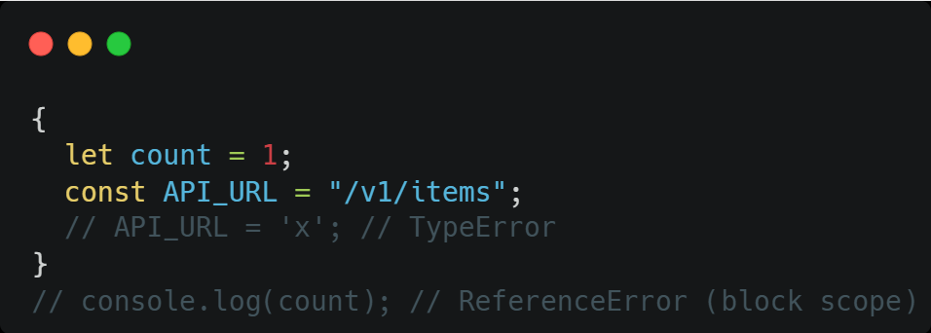
ES6 - let & const (Block Scope)
let and const are block-scoped.
const must be initialized and cannot be reassigned (but object contents can change).
Prevents bugs from function-scoped var.

Slide 94
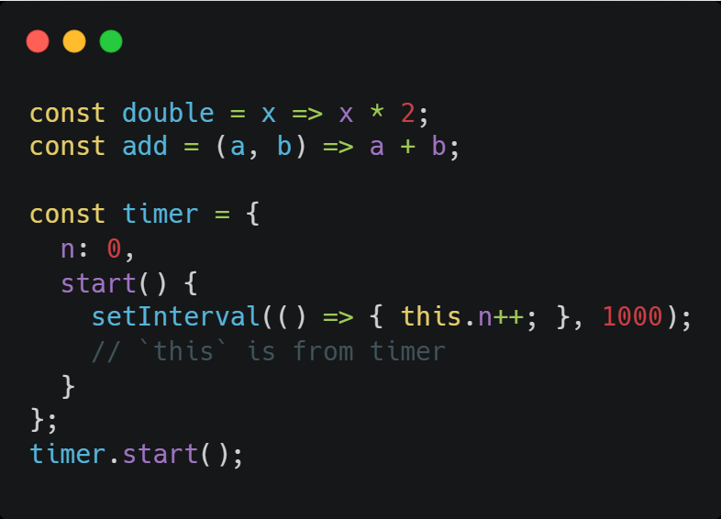
ES6 - Arrow Functions
Concise syntax; this is lexically bound (inherits from surrounding scope).

Slide 95
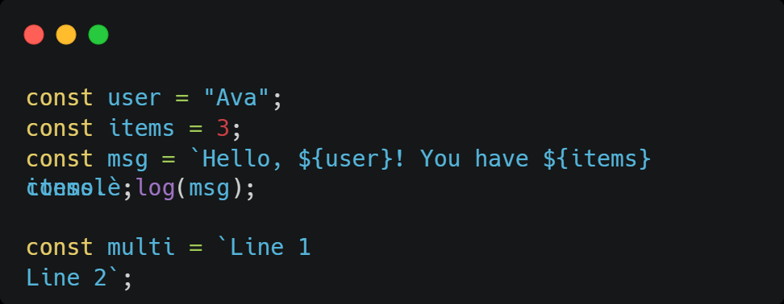
ES6 - Template Literals
Backticks (`` ` ``) allow **interpolation** and **multiline** strings.

Slide 96
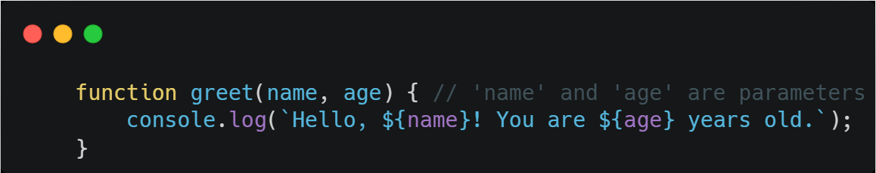
ES6 - Parameter
A parameter is a variable listed in a function's definition. It acts as a placeholder for the data that the function expects to receive when it is called. Parameters are defined within the parentheses of a function declaration.

Slide 97
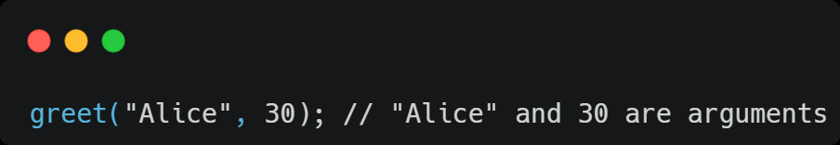
ES6 - Argument
An argument is the actual value that is passed to a function when it is invoked. These values are assigned to the corresponding parameters within the function's scope during execution

Slide 98
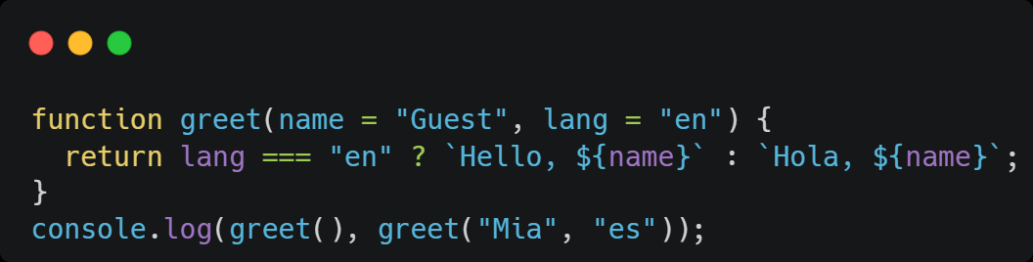
ES6 - Default Parameters
Give function parameters default values

Slide 99
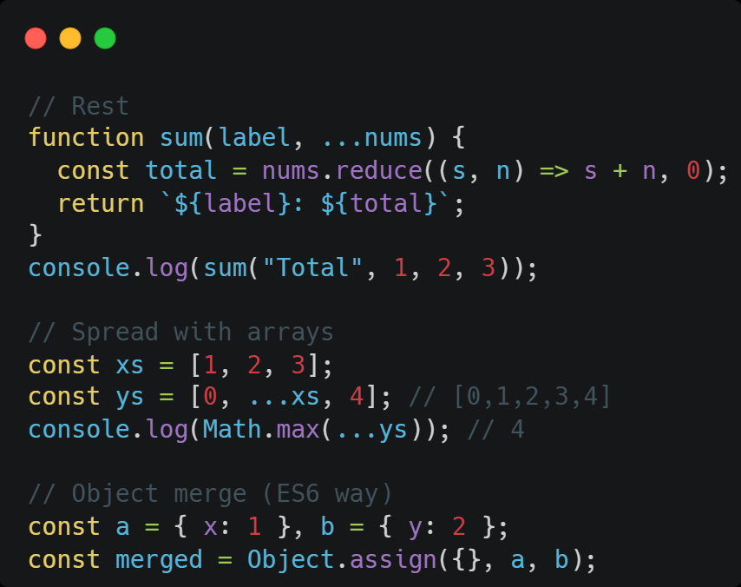
ES6 - Rest Parameters & Spread
Rest: collect remaining arguments into an array.
Spread: expand iterables in calls/array literals.
Note: Object spread/Rest is not ES6 (it’s ES2018). Use Object.assign for objects in ES6.

Slide 100
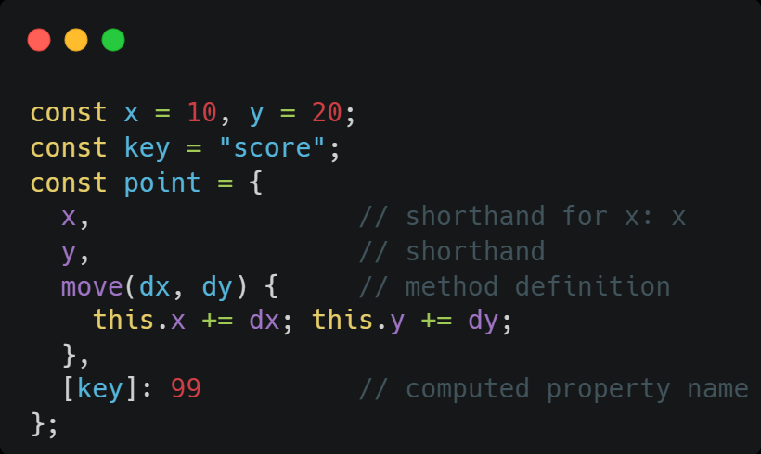
ES6 - Enhanced Object Literals
Property shorthand, method definitions,computed property names

Slide 101
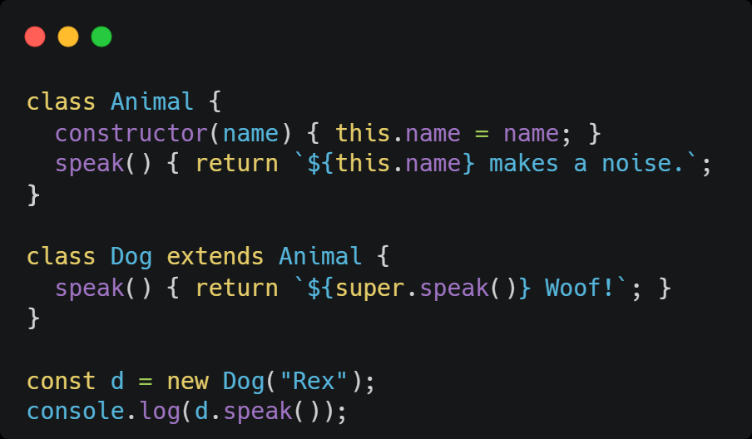
ES6 - Classes
Cleaner way to define constructor functions and methods.
Supports `extends` and `super` for inheritance.

Slide 102
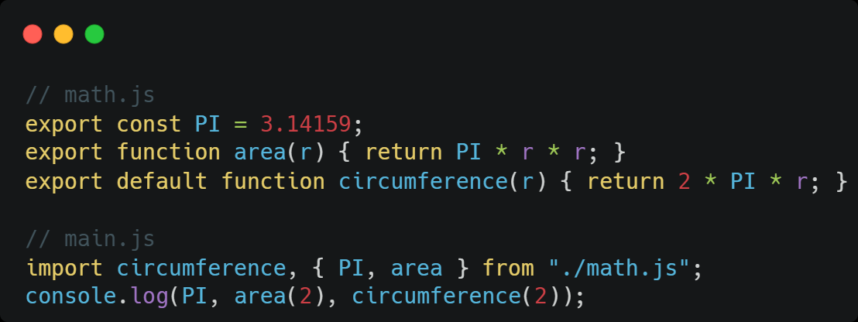
ES6 - Modules
ES6 modules provide **static** imports/exports.
In browsers, use `<script type="module">`; in Node environments, use ESM support or bundlers.

Slide 103
Day 2 : Topics
SQL Vs NoSQL
REST API
Node JS
Express JS Framework

Slide 104
Day 2 : Practices
Develop a Simple Client-Server application using Node JS and Express

Slide 105
REST-API
A RESTful API (Representational State Transfer Application Programming Interface) is an architectural style for designing networked applications. It leverages standard HTTP methods to interact with resources, typically represented by URLs, enabling communication between different systems over the internet.

Slide 106
RESTful API Design Considerations
Resource-based Naming
Use clear, intuitive, and noun-based URLs to represent resources (e.g., /users, /products/123).
HTTP Methods
Utilize appropriate HTTP methods for operations (GET for retrieve, POST for create, PUT for update/replace, PATCH for partial update, DELETE for remove).
Status Codes
Use standard HTTP status codes to indicate the outcome of requests (e.g., 200 OK, 201 Created, 404 Not Found, 500 Internal Server Error).
Data Formats
Commonly use JSON or XML for request and response bodies.
Versioning
Implement versioning to manage changes and ensure backward compatibility for clients.

Slide 107
RESTful API Security
Authentication: Verify the identity of clients (e.g., API keys, OAuth 2.0, JWT).
Authorization: Control access to resources based on user roles and permissions.
Encryption: Use HTTPS/TLS to encrypt data in transit, preventing eavesdropping and tampering.
Input Validation and Sanitization: Prevent injection attacks and data manipulation by validating and sanitizing all input.
Rate Limiting: Protect against abuse, misuse, and denial-of-service attacks by limiting the number of requests a client can make within a given timeframe.
Logging and Monitoring: Track API usage and detect suspicious activities for security auditing and incident response.

Slide 108
Node.js
Node.js is an open-source, cross-platform JavaScript runtime environment that allows developers to execute JavaScript code outside of a web browser. Traditionally, JavaScript was confined to client-side web development within browsers. Node.js, built on Google Chrome's V8 JavaScript engine, extended JavaScript's capabilities to server-side and general-purpose programming.

Slide 109
Node.js : Key characteristics
JavaScript Runtime: Node.js provides the environment to run JavaScript code directly on a computer or server, enabling server-side development, command-line tools, and more.
Event-Driven, Non-Blocking I/O: Node.js utilizes an event-driven, non-blocking input/output (I/O) model. This means that operations like reading from a file or making a network request do not block the execution of other code. Instead, Node.js uses an event loop to handle multiple tasks concurrently, making it efficient for handling high volumes of concurrent connections and real-time applications.

Slide 110
Node.js : Key characteristics …cont
Scalability: The non-blocking nature and event loop contribute to Node.js's ability to build scalable network applications that can handle many concurrent users or requests efficiently.
Server-Side Capabilities: It provides functionalities for building web servers, creating REST APIs, interacting with databases, handling file system operations, and other common server-side tasks.
npm (Node Package Manager): Node.js comes with npm, a vast ecosystem of open-source libraries and packages that developers can easily integrate into their projects, accelerating development.

Slide 111
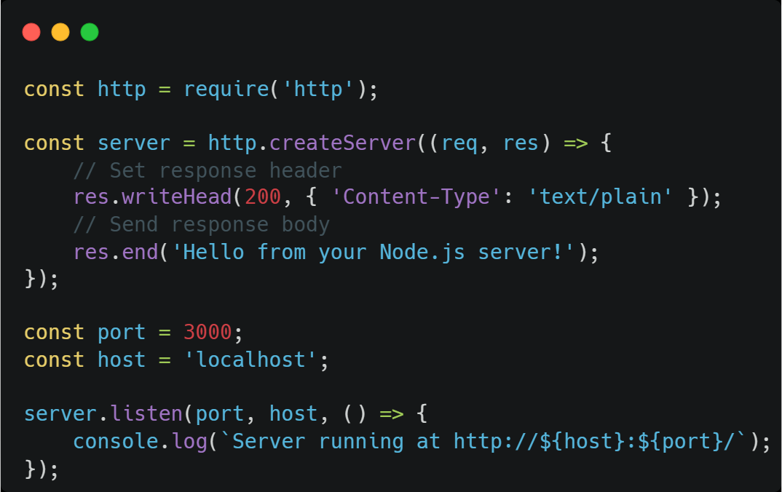
Node.js : Server Creation
Create Server File: Create a JavaScript file (e.g., server.js) in your project directory.
Write Server Code: Use the http module to create and listen for requests
http.createServer(): Creates an HTTP server instance.
The callback function handles incoming requests (req) and prepares responses (res).
res.writeHead(): Sets the HTTP status code and response headers.
res.end(): Sends the response body and signals the end of the response.
server.listen(): Starts the server and makes it listen for incoming connections on the specified port and host.

Slide 112
Node.js : req (Request Object)
The req object represents the incoming HTTP request received by the server from a client. It encapsulates all information related to the request, including:
Request parameters:
Data extracted from the URL path (e.g., /users/:id).
Query strings:
Key-value pairs appended to the URL after a question mark (e.g., /search?query=nodejs).
Request body:
Data sent by the client, often in JSON or form-encoded format, for methods like POST or PUT.
Headers:
HTTP headers providing metadata about the request (e.g., Content-Type, Authorization).

Slide 113
Node.js : res (Response Object)
The res object represents the HTTP response that the server will send back to the client. It provides methods to control various aspects of the response, such as:
Sending data:
Methods like res.send(), res.json(), or res.render() to send content back to the client.
Setting HTTP status codes:
Using res.status() to indicate the outcome of the request (e.g., 200 OK, 404 Not Found).
Setting headers:
Using res.set() to add or modify response headers

Slide 114
Node.js : HTTP Status Codes
HTTP status codes are three-digit numbers sent by the server in the response to indicate the status of the request. They are categorized into five classes:
1xx Informational: Request received, continuing process.
2xx Success: The action was successfully received, understood, and accepted (e.g., 200 OK, 201 Created).
3xx Redirection: Further action needs to be taken to complete the request (e.g., 301 Moved Permanently).
4xx Client Error: The request contains bad syntax or cannot be fulfilled (e.g., 400 Bad Request, 404 Not Found, 401 Unauthorized).
5xx Server Error: The server failed to fulfill an apparently valid request (e.g., 500 Internal Server Error).

Slide 115
Node.js : HTTP Methods
HTTP methods define the type of action a client wants to perform on a resource. The most common methods include:
GET: Retrieves data from the server.
POST: Submits new data to the server, typically for creation.
PUT: Updates existing data on the server, replacing the entire resource.
PATCH: Partially updates existing data on the server.
DELETE: Removes a resource from the server.

Slide 116
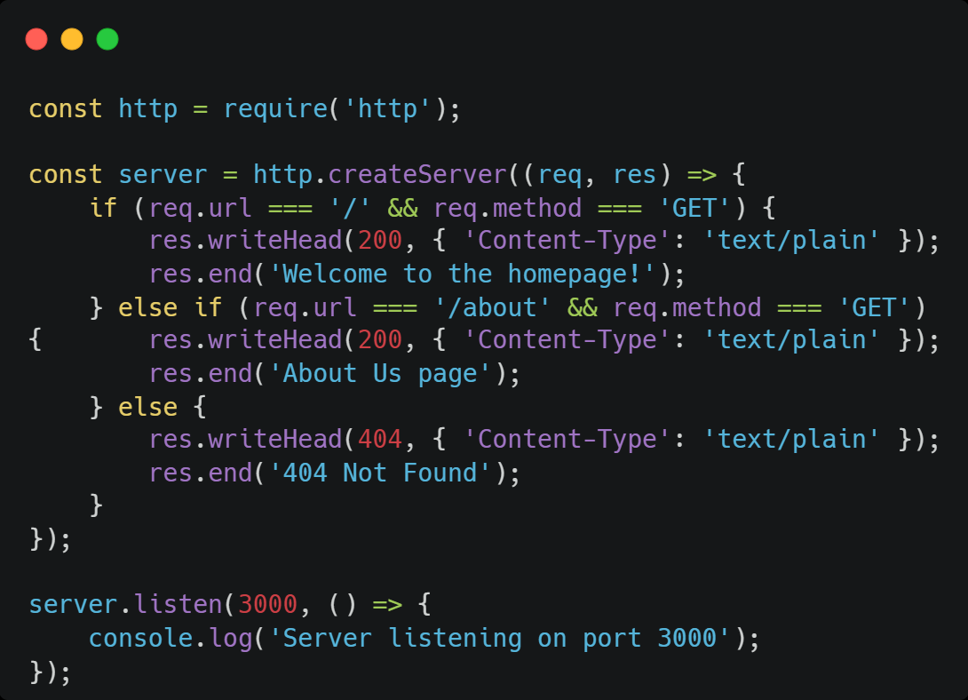
Node.js : Routing
Routing determines how an application handles incoming HTTP requests based on the request's URL (path) and HTTP method (e.g., GET, POST, PUT, DELETE).

Slide 117
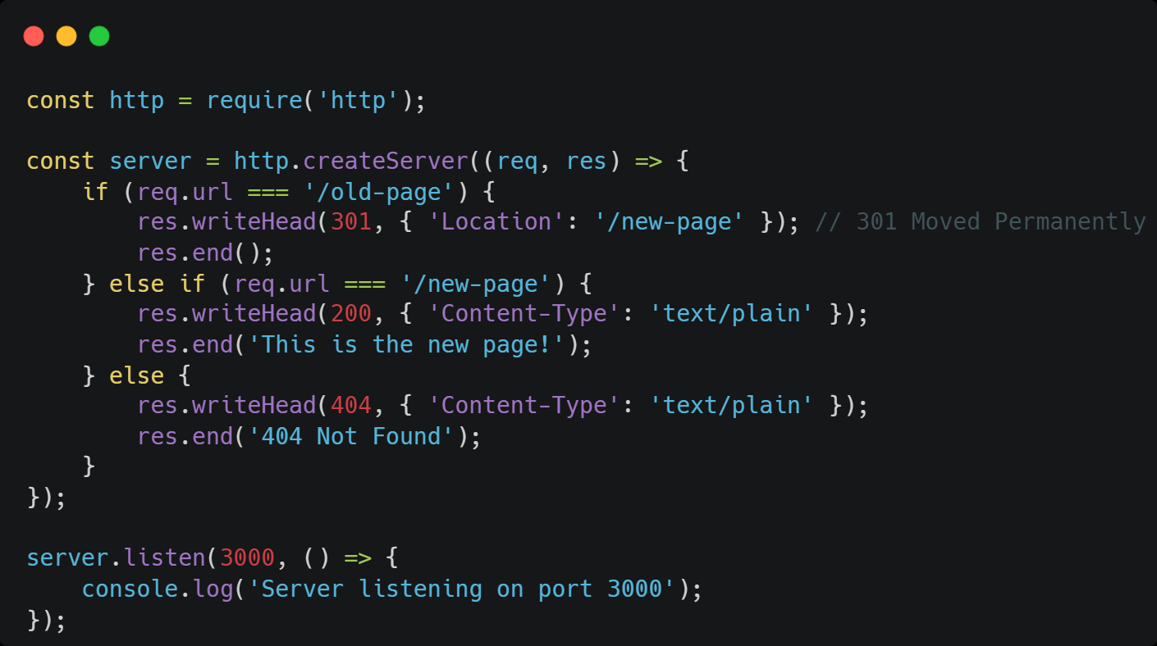
Node.js : Redirection Requests
Redirection involves sending a client to a different URL than the one originally requested. This is achieved by setting the Location header in the HTTP response and sending an appropriate HTTP status code. Core HTTP Module Redirection.

Slide 118
Express.js
Express.js is a minimalist and flexible Node.js web application framework designed to simplify the development of web applications and APIs. It provides a robust set of features for handling HTTP requests, routing, middleware, and more, making backend development with JavaScript more efficient and organized.

Slide 119
Express.js
Framework for Node.js
Routing
Middleware: Middleware functions are functions that have access to the request object, the response object, and the next middleware function in the application's request-response cycle. They can perform various tasks like logging, authentication, data parsing, and error handling.
HTTP Utilities: It provides helpful utilities for managing HTTP requests and responses, such as handling redirects, setting headers, and working with cookies and sessions.
Templating Engine Support: Express can be integrated with various templating engines (e.g., EJS, Pug, Handlebars) to dynamically generate HTML responses by inserting data into templates.
Scalability: Its lightweight nature and modular design contribute to building scalable web applications and APIs.

Slide 120
Express.js - Key Concepts
Routing:
Defines how an application responds to client requests to specific endpoints, using methods like app.get(), app.post(), app.put(), and app.delete().
Middleware:
Functions that have access to the request object (req), the response object (res), and the next middleware function in the application's request-response cycle. Middleware can perform tasks like logging, authentication, and parsing request bodies.
Template Engines:
Supports various template engines (e.g., Pug, EJS, Handlebars) for rendering dynamic HTML content.
Static File Serving:
Easily serves static assets like HTML, CSS, JavaScript files, and images.

Slide 121
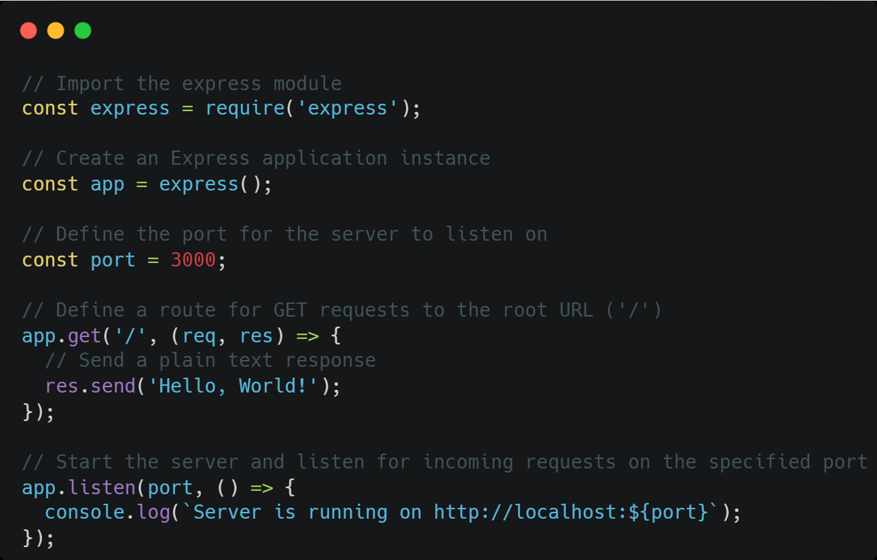
Express.js - Code

Slide 122
Day 3 : Topics
React JS - Components, Props, State, Hooks
React Router
React Redux

Slide 123
Day 3 : Practices
Develop a Dynamic SPA using React JS & React Router
Create a to-do list application using React JS with Redux

Slide 124
React
Components
JSX (JavaScript XML)
Virtual DOM
Props (Properties)
State
Hooks

Slide 125
React: Intro
React is a JavaScript library for building user interfaces, particularly single-page applications.
Component-based architecture
Utilizes a Virtual DOM for efficient rendering.

Slide 126

React: Components
React applications are built from independent, reusable pieces of UI called components.
Components can be either functional components (simple JavaScript functions) or class components (ES6 classes).
They encapsulate their own logic and rendering instructions, promoting modularity and reusability.

Slide 127
React: JSX
JSX is a syntax extension that allows writing HTML-like code directly within JavaScript.
It enables a more intuitive way to describe the UI structure within React components.
JSX is transpiled into regular JavaScript before being executed by the browser.

Slide 128
React: Virtual DOM
React maintains a lightweight in-memory representation of the actual browser DOM, known as the Virtual DOM.
When a component's state changes, React first updates the Virtual DOM.
It then efficiently compares the Virtual DOM with the real DOM and only updates the necessary parts of the real DOM, minimizing direct DOM manipulation and improving performance.

Slide 129

React: Props
Props are read-only data passed from a parent component to a child component.
They enable data flow and configuration of child components, allowing them to display dynamic content or behave differently based on the provided props.

Slide 130

React: State
State refers to data that is internal to a component and can change over time.
When the state of a component changes, React re-renders the component and its children to reflect the updated data.
In functional components, the useState Hook is used to manage state.

Slide 131
React: Hooks
Hooks are functions that allow functional components to "hook into" React features like state and lifecycle methods.
Commonly used Hooks include useState for managing component-specific state and useEffect for handling side effects (e.g., data fetching, DOM manipulation).

Slide 132

React: Hooks ~ Code

Slide 133
React: useEffect (Side Effects)
The useEffect Hook in React allows functional components to perform "side effects."
Where we can use this?
Data Fetching: Making API calls to retrieve or send data.
DOM Manipulation: Directly interacting with the browser's Document Object Model (e.g., changing the document title, adding event listeners).

Slide 134

React: useEffect (Side Effects) ~ Code

Slide 135
React: useCallback
useCallback is a React Hook that returns a memoized version of a callback function. This means that as long as its dependencies haven't changed, React will return the same function instance across renders, preventing the function from being recreated on every
useCallback addresses this by memoizing the function. It takes two arguments:

Slide 136

React: useCallback ~ Code

Slide 137

React: useRef
The useRef hook in React provides a way to create a mutable reference that persists across component re-renders without causing a re-render itself. It returns an object with a single current property, which can hold any mutable value.
Accessing and Interacting with DOM Elements: This is a primary use case. You can attach a ref created with useRef to a DOM element in your JSX using the ref attribute. This allows you to directly access the underlying DOM element and perform actions like focusing an input, playing/pausing media, or triggering animations.

Slide 138
React: Router
React Router is a widely used routing library for React applications. It enables the creation of Single-Page Applications (SPAs) with client-side routing, meaning that navigation between different views or "pages" within the application occurs without a full page reload from the server.

Slide 139
React: Router Components
BrowserRouter (or HashRouter): These components wrap your entire application or the part of your application where routing is needed. They manage the history and synchronize the UI with the URL.
Routes: This component acts as a container for individual Route components. It ensures that only one Route that matches the current URL is rendered.
Route: This component defines a single route, specifying the path (the URL pattern) and the element (the React component to render when the path matches).
Link (or NavLink): These components are used to create navigation links within your application. They prevent full page reloads and handle the client-side navigation.
Outlet: Used for nested routing, Outlet acts as a placeholder within a parent route's component where child routes will be rendered.

Slide 140

React: Router ~ Code

Slide 141
React: Redux (State Management)
Redux is a predictable state container for JavaScript applications, commonly used with React to manage application state in a centralized and organized manner. While React components have their own internal state, Redux provides a global store for managing shared state across multiple components, especially in complex applications.

Slide 142
React: Redux - Key Concepts
Store : The single source of truth for your application's state. It holds the entire application state in a single, immutable JavaScript object.
Actions: Plain JavaScript objects that describe what happened in the application. They are the only way to trigger state changes. Actions must have a type property, and can optionally contain a payload with data.
Reducers : Pure functions that take the current state and an action as arguments, and return a new state. They specify how the application's state changes in response to actions. Reducers must not mutate the original state directly.
Dispatch : The method used to send actions to the Redux store. When an action is dispatched, Redux calls the appropriate reducer(s) to update the state.
Selectors : Functions used to extract specific pieces of data from the Redux store's state, providing a way to access and derive data from the central store.

Slide 143
React: Redux - Workflow
Action Dispatch:
A React component dispatches an action (a plain JavaScript object describing what happened) in response to a user interaction or an event.
Reducer Processing:
The dispatched action reaches the reducer, a pure function that takes the current state and the action as input, and returns a new state based on the action's type.
Store Update:
The Redux store receives the new state from the reducer and updates its internal state tree.
Component Re-rendering:
React Redux detects the state change in the store and notifies connected React components. These components then re-render with the updated data.

Slide 144

React: Redux - Workflow

Slide 145

React: Redux - Store Setup

Slide 146

React: Redux - Slice

Slide 147

React: Redux - Component

Slide 148

React: Redux - Root Component with Provider

Slide 149
Day 4 : Topics
React Context & Provider
React Styling, CSS Modules, CSS in JS, and Tailwind CSS
React Jest
PWA
SQL and NoSQL

Slide 150
Day 4 : Practices
Develop a RESTful API using Node JS & Express jS
Integrate JWT authentication in a Node JS
Create a Progressive Web APP
Testing React Component using JEST

Slide 151
React: Context & Provider
React Context and Provider are fundamental parts of the React Context API, designed to address the issue of "prop drilling" and enable efficient state management across components.

Slide 152

React: Context
React Context provides a way to share data that can be considered "global" for a tree of React components, without having to manually pass props down through every level of the component tree. It acts as a central storage for specific data or state that multiple components might need to access.

Slide 153

React: Context.Provider
The Context.Provider component is a special component provided by React that allows its child components to subscribe to a specific context. It serves as the source of truth for the context's value within its subtree.

Slide 154

React: Context.Provider ~ Code (Auth Ex.)

Slide 155

React: Context.Provider ~ Code (Auth Usage)

Slide 156

React: Styling
Styles are applied directly to React elements using the style prop, which accepts a JavaScript object.
CSS properties are written in camelCase (e.g., backgroundColor instead of background-color).

Slide 157


React: CSS Modules
CSS Modules provide local scoping for CSS classes, preventing naming conflicts between components.
Each CSS file is treated as a module, and class names are automatically generated to be unique.

Slide 158

React: CSS-in-JS Libraries
Libraries like styled-components or Emotion allow writing CSS directly within JavaScript files using tagged template literals.
This approach enables component-based styling, dynamic styles based on props, and easy theme integration.

Slide 159

React: Tailwind CSS (utility-first)
Tailwind CSS, when used with React, embodies a "utility-first" approach to styling. This paradigm shifts away from traditional semantic CSS classes and instead provides a vast collection of single-purpose utility classes that directly correspond to specific CSS properties.

Slide 160
React: PWA
A Progressive Web App (PWA) is a web application that utilizes modern web technologies to provide an app-like experience to users. PWAs are designed to be reliable, fast, and engaging, working across different devices and browsers. They leverage features like

Slide 161
React: PWA - Key Concepts
App-like Experience: PWAs aim to provide a user experience similar to native mobile apps, with features like full-screen display, smooth transitions, and access to device hardware.
Push Notifications: PWAs can send push notifications to users, even when the app is not actively open, improving user engagement and re-engagement.
Offline Functionality: PWAs can store website content and assets locally using service workers, allowing users to access the app even without an internet connection.
Cross-Platform Compatibility: PWAs are built using web technologies and can run on various devices and browsers, including desktops, smartphones, and tablets.
Web App Manifest: This JSON file provides metadata about the PWA, such as its name, icons, and start URL. This allows users to install the app to their device's home screen and launch it like a native app.

Slide 162
React: Jest
Jest is a JavaScript testing framework developed by Meta, specifically designed for testing React applications, among other JavaScript projects. It acts as a test runner, executing your tests and providing a robust environment for verifying the functionality of your React components.

Slide 163
Database : SQL & NoSQL
SQL and NoSQL represent two fundamentally different approaches to database management, each with distinct characteristics regarding data structure, scalability, and query language.

Slide 164
SQL Databases
Structure:
SQL databases are relational, organizing data into tables with predefined schemas. Each table consists of rows and columns, and relationships between tables are established using foreign keys.
Scalability:
Traditionally, SQL databases scale vertically, meaning performance is enhanced by upgrading hardware resources (e.g., CPU, RAM) on a single server.
Query Language:
They utilize Structured Query Language (SQL) for data definition, manipulation, and retrieval. SQL provides a standardized way to interact with the database.
Data Consistency:
SQL databases prioritize ACID (Atomicity, Consistency, Isolation, Durability) properties, ensuring high data integrity and reliability, especially crucial for transactional systems.

Slide 165
NoSQL Databases
Structure: NoSQL databases are non-relational and offer various flexible data models, including document-oriented (e.g., MongoDB), key-value stores (e.g., Redis), wide-column stores (e.g., Cassandra), and graph databases (e.g., Neo4j). They typically have dynamic or flexible schemas.
Scalability: NoSQL databases are designed for horizontal scalability, allowing performance improvement by distributing data across multiple servers or nodes. This makes them suitable for handling large volumes of data and high traffic.
Query Language: They do not exclusively use SQL. Instead, they employ various query methods specific to their data model, often using APIs or query languages tailored for their particular structure.
Data Consistency: NoSQL databases often prioritize availability and partition tolerance over strict consistency (following the CAP theorem), offering eventual consistency in distributed environments.

Slide 166
SQL vs NoSQL
Feature | SQL Databases | NoSQL Databases
Data Model | Relational (tables, rows, columns, schema) | Non-relational (document, key-value, graph, etc.)
Schema | Predefined and rigid | Dynamic or flexible
Scalability | Vertical (scale up) | Horizontal (scale out)
Query Language | SQL | Various APIs and query languages
Consistency | ACID properties (strong consistency) | Often eventual consistency (prioritizes availability)

Slide 167
Day 5: Topics
Web Sockets
Microservices
API Gateway
Web Security

Slide 168
Day 5 : Practices
Use WebSockets & Create Real-Time Web App
Handle web security
CI/CD using Github & AWS S3

Slide 169
Web Sockets
WebSockets provide a persistent, bidirectional communication channel between a client (like a React.js application) and a server (like a Node.js server), enabling real-time data exchange. This differs from traditional HTTP requests, which are stateless and require a new connection for each request and response.

Slide 170
Web Sockets : Benefits
Real-time Updates:
Enables instant data synchronization for applications like chat, live dashboards, and collaborative editing.
Reduced Overhead:
Eliminates the need for repeated connection establishments, improving efficiency compared to polling with HTTP.
Bidirectional Flow:
Allows both client and server to initiate communication, facilitating dynamic interactions.

Slide 171
Web Sockets : Workflows
Handshake:
The process begins with the client sending an HTTP request to the server. This request includes specific headers, notably Connection: Upgrade and Upgrade: websocket, indicating the client's desire to switch protocols to WebSocket.
Protocol Upgrade:
The server, if it supports WebSockets and accepts the upgrade request, responds with an HTTP status code 101 Switching Protocols. This response confirms the agreement to switch from HTTP to the WebSocket protocol.
Connection Establishment:
Upon successful handshake, a single, persistent TCP connection is established between the client and the server. This connection remains open until explicitly closed by either party or interrupted by network issues.

Slide 172
Web Sockets : Workflows …cont
Bidirectional Communication:
Once the connection is established, both the client and the server can send and receive messages independently and in real-time. This full-duplex nature allows for immediate data exchange without the overhead of initiating new connections for each message, as is common with HTTP.
Data Exchange (Framing):
Messages exchanged over the WebSocket connection are encapsulated in "frames." These frames contain the actual data and metadata, and the WebSocket protocol defines how these frames are constructed and interpreted by both client and server.
Connection Closure:
Either the client or the server can initiate the closure of the WebSocket connection by sending a specific control frame. Once a close frame is received and acknowledged, the connection is terminated.

Slide 173
MicroServices
Microservices are an architectural approach to developing software applications as a collection of small, independent services that communicate with each other over a network. Instead of building a monolithic application where all the functionality is tightly integrated into a single codebase, microservices break down the application into smaller, loosely coupled services.

Slide 174
Key characteristics of Microservices Arch.
Loose Coupling:
Services are independent and have minimal dependencies on each other. Changes in one service ideally do not require changes or redeployments in other services.
Independent Deployment:
Each service can be deployed independently, allowing for faster release cycles and continuous delivery.
Decentralized Data Management:
Each microservice typically manages its own data store, optimized for its specific needs, rather than sharing a central database.
Organized Around Business Capabilities:
Services are designed to encapsulate a specific business capability or domain, promoting clear ownership and responsibility.

Slide 175

API Gateway
An API Gateway is a key component in system design, particularly in microservices architectures and modern web applications. It serves as a centralized entry point for managing and routing requests from clients to the appropriate microservices or backend services within a system.

Slide 176
API Gateway
An API Gateway serves as a reverse proxy between clients and backend services.
After receiving incoming client requests, it manages a number of responsibilities, including rate limitation, routing, and authentication, before forwarding the requests to the appropriate backend services.
Offers a consistent interface and hiding the complexity of the underlying architecture

Slide 177
How does API Gateway work?
Routing
Protocol translation
Request aggregation
Authentication and authorization
Rate limiting and throttling
Load balancing
Caching
Monitoring and logging

Slide 178
Web Security
SQL Injection (SQLi)
Cross-Site Scripting (XSS)
Cross-Site Request Forgery (CSRF)
Cross-Origin Resource Sharing (CORS)

Slide 179
SQL Injection (SQLi)
SQL Injection is a code injection technique that exploits vulnerabilities in an application's database interactions. Attackers insert malicious SQL code into input fields, which the application then executes, potentially allowing unauthorized access, data manipulation, or data deletion from the database.

Slide 180
Cross-Site Scripting (XSS)
Cross-Site Scripting is a client-side code injection attack where malicious scripts are injected into trusted websites. When a user visits the compromised page, their browser executes the script, which can then steal sensitive information (like cookies), deface the website, or redirect the user to malicious sites. XSS can be reflected (payload in URL), persistent (payload stored on server), or DOM-based (payload executed in the browser's Document Object Model).

Slide 181
Cross-Site Request Forgery (CSRF)
Cross-Site Request Forgery tricks authenticated users into performing unintended actions on a web application. An attacker crafts a malicious request (e.g., a hidden form or image) and embeds it on a site the victim visits. If the victim is logged into the target application, their browser automatically sends their session credentials with the request, leading to unauthorized actions (like fund transfers or password changes).

Slide 182
Cross-Origin Resource Sharing (CORS)
CORS is a browser security mechanism that restricts web pages from making requests to a different origin (domain, protocol, or port) than the one serving the current page. It's a security feature to prevent malicious scripts from one domain from accessing resources on another without explicit permission. The server must explicitly allow cross-origin requests by setting Access-Control-Allow-Origin headers. While not a vulnerability itself, misconfigured CORS can weaken security and enable other attacks.

